Slide 1


State of Alaska
Invasive Species
Brianne Blackburn
(907) 745-8785
Brianne.Blackburn@alaska.gov
Division of Agriculture
Alaska Department of Natural Resources

Slide 2
State of Alaska
Invasive Species
  What are invasive species
  What is in place for DNR to manage invasive species
  What are our current priorities
  Coordination efforts

Slide 3
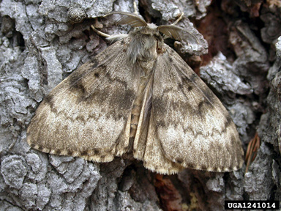
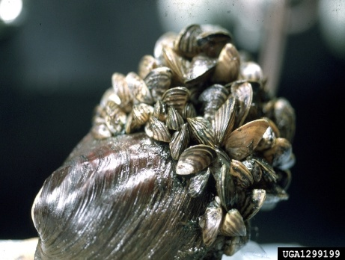
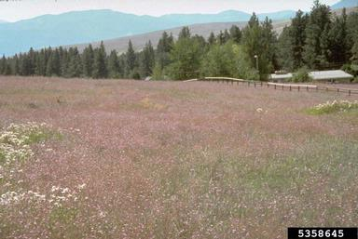
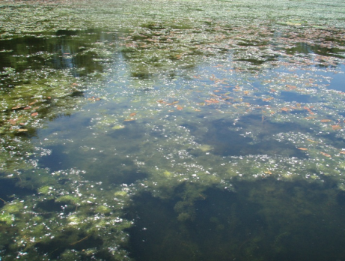
Invasive Species in Alaska
  Definition:
    Non-native to the ecosystem under consideration
    Whose introduction causes or is likely to cause economic or environmental harm or harm to human health
Presidential Executive Order 13112
Asian Gypsy Moth
Zebra Mussel
Spotted Knapweed
Elodea
In Alaska, plant biologists and natural resource managers are tracking 332 non-native plants for potential invasiveness

Slide 4
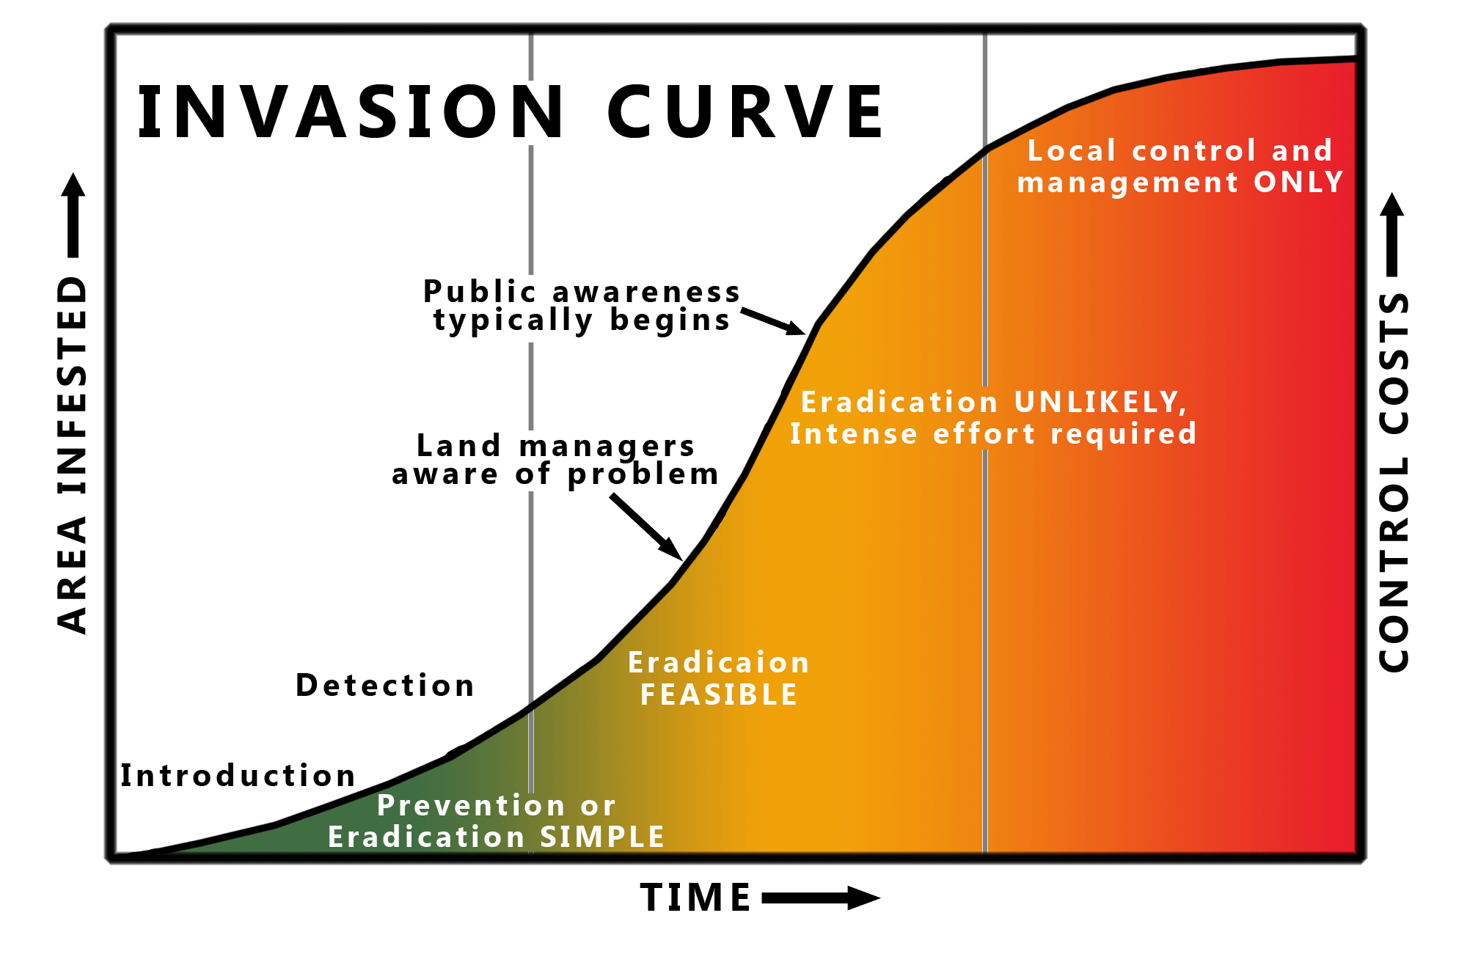
Typical Species Invasion Curve
$$

Slide 5
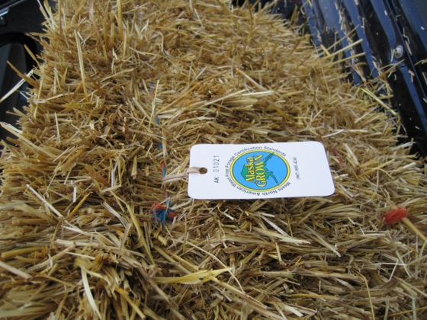
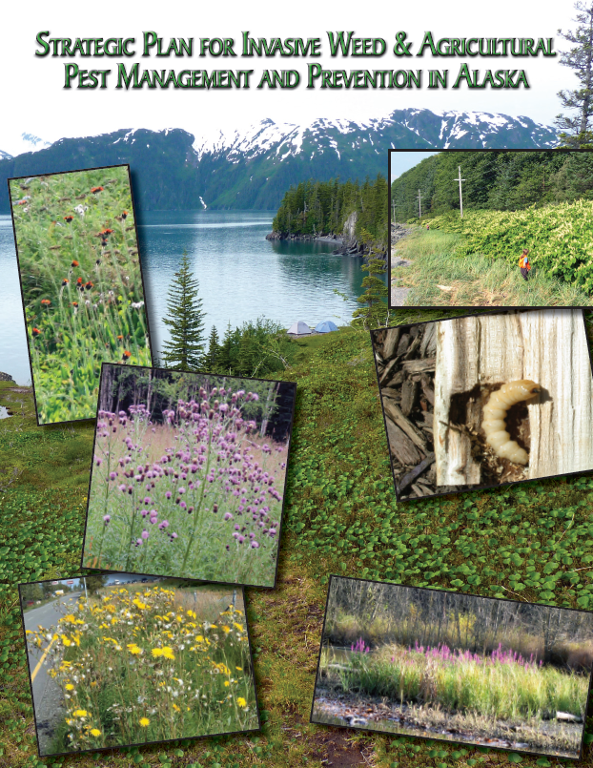
Invasive Species in Alaska
Department of Natural Resources
  Inspection and grading of agricultural products (Labeling-Weed Free Forage Program)
  Coordination, planning, regulation review
  Regulate and control the entry, transport of seeds, plants and other horticultural or agricultural products
  Control and eradicate the spread of pests
• AS 03.05.010 • AS 03.05.030 • AS 03.05.027 • AS 44.37.030 •

Slide 6

Invasive Species in Alaska
Department of Fish & Game
AS 15.05.020
  Maintain and protect fish, game & aquatic plant resources
Aquatic Nuisance Species Management Plan-2002
  Alaska’s history of invasion,
  Species considered to be the highest threat,
  Pathways for introduction
  Management actions to:
    prevent the introduction or spread of invasive species,
    promote early detection and rapid response actions,
    And control or eradicate invasive species.
Report an Invasive!
1-877-INVASIV
(1-877-468-2748)

Slide 7
Projects
Control & Management
Canada Thistle Containment, Anch.
Outreach & Education
Horticulture Industry Coordination
Inventory & Monitoring
Giant Hogweed & Purple Loosestrife
Certifications
Gravel
Purple Loosestrife eradication, Anch.
EDRR
Gravel Pit
Weed Free Forage

Slide 8
Strategic Plan
Prevention
  Regulations & Policy
    Coordination
      Early Detection
        & Rapid Response
        Control & Management
          Inventory & Monitoring
            Education
              Research
http://plants.alaska.gov/invasives/strategic-plan.php

Slide 9

Regulations
Under Review..
11 AAC 34
  Seed Laws
  Quarantine laws
  Pest Laws
Commissioner’s review
Public Review
  Should be out soon!

Slide 10
Coordination
Alaska Invasive Species Working Group
Committee for Noxious & Invasive Plants Management
Cooperative Weed Management Areas
  Juneau
  Kenai Peninsula
  Anchorage
  Kodiak
  Mat-Su
  Fairbanks
Soil & Water Conservation Districts

Slide 11
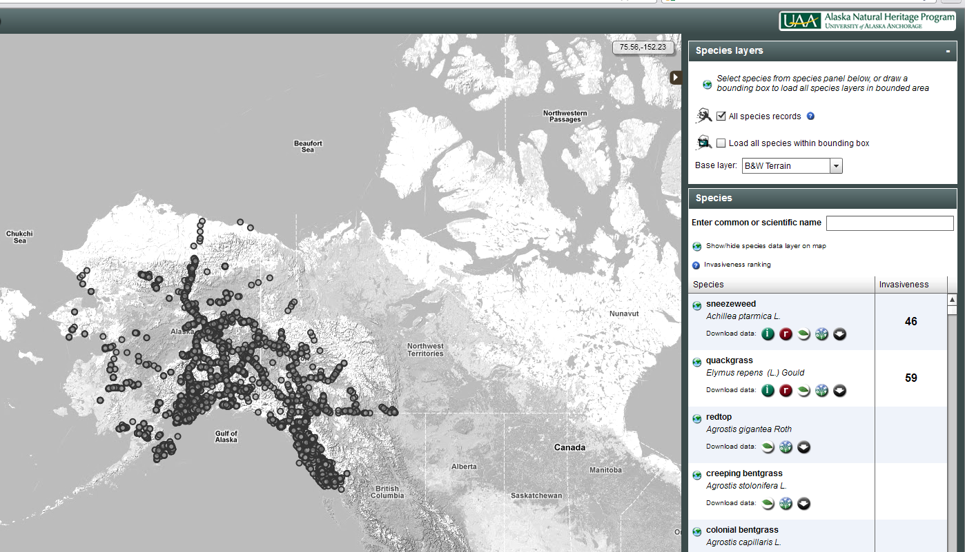
Coordination
AKEPIC (Natural Heritage Program)
Tracking & Ranking Non-native plant species in Alaska
http://aknhp.uaa.alaska.edu/botany/akepic

Slide 12
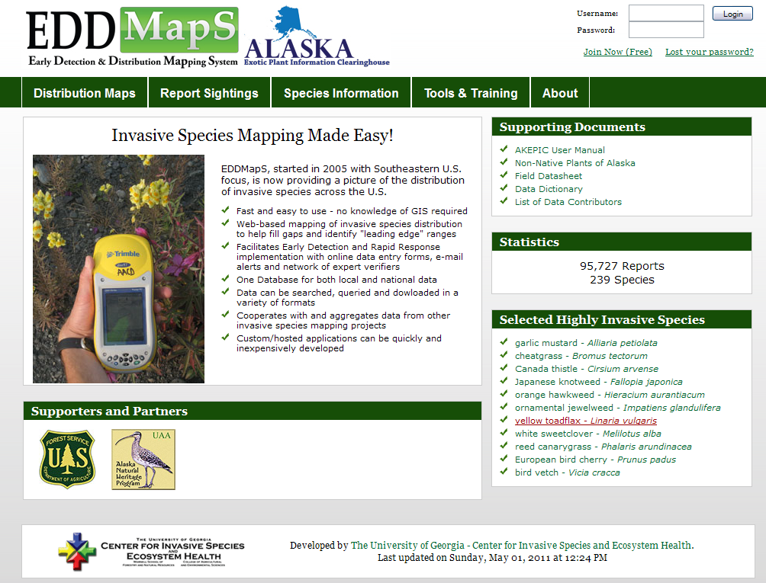
Coordination
Nation-wide Early Detection and Distribution Mapping System brought to Alaska
http://www.eddmaps.org/alaska/

Slide 13
State of Alaska
Invasive Species
Division of Agriculture
Alaska Department of Natural Resources
Brianne Blackburn
(907) 745-8785
Brianne.Blackburn@alaska.gov

