Slide 1
Review of existing REFORESTATION standards

Slide 2
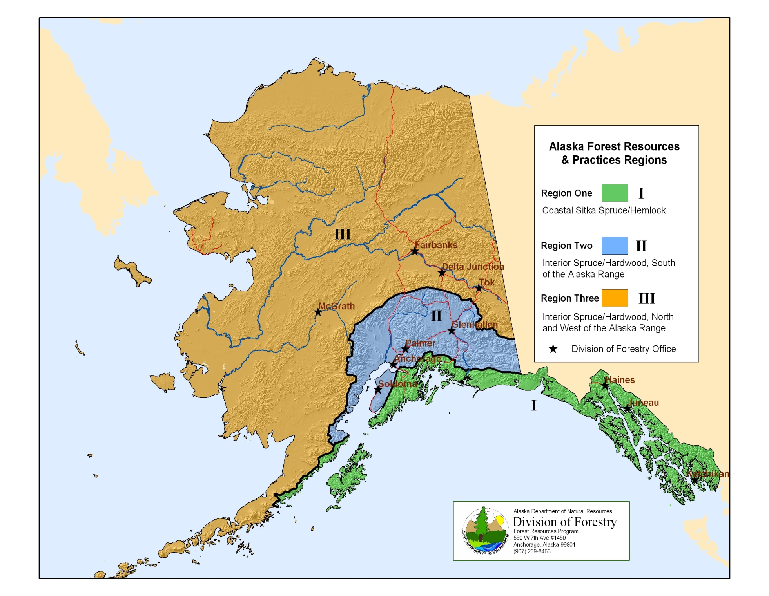

Slide 3
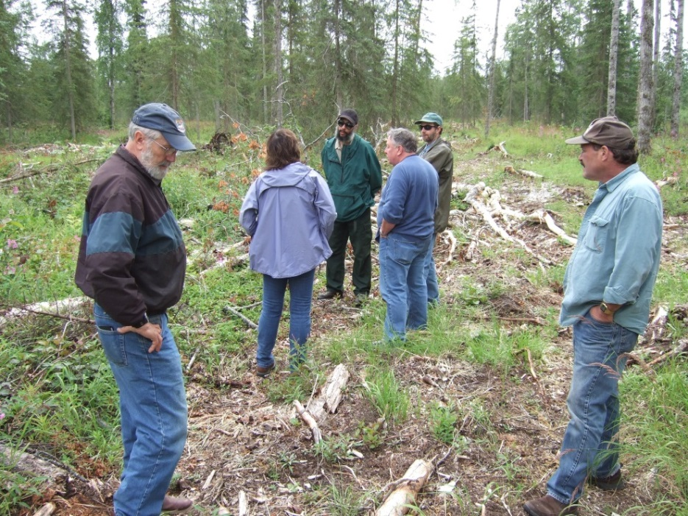
FRPA – Applicability
Governs commercial forest operations: timber harvesting, forest access, and reforestation
Applies to state, municipal, trust, and private land
Operations adjacent to surface waters, or >40 ac in RII, or >40 in RIII for landowners who own >160 acres
BOF field visit to Kenai logging operation

Slide 4
Is the operation on forest land that is not developed for another use or being converted* to another use?
Does the operation involve harvesting, road construction, site prep, PCT, slash treatment, or any other activity leading to or connected with commercial timber harvest?
YES
YES
Does it annually produce for sale >10 MBF in Region II or >30 MBF in Region III?
NO
NO
NO
YES
FRPA does not apply
FRPA does not apply
FRPA does not apply
Is it adjacent to surface waters or
In aggregate, is it >40 acres?
Where does FRPA apply in Regions II and III?
NO
YES
FRPA does not apply
Is it in Region II or in Region III?
III
II
FRPA does not apply
NO
Does the landowner own a total of >160 acres?
FRPA Applies
*A DPO is still required for a land use conversion unless the conversion is already authorized by a borough or municipality (e.g., plat approval or building permit)
FRPA Applies
YES

Slide 5
Statute – FRPA - Conversion
Sec. 41.17.110. Conversion of forest land to other uses. An intention to convert forest land to other uses after timber harvesting may be stated in the DPO submitted under AS 41.17.090. In that event, reforestation requirements adopted under this chapter do not apply, except that conversion shall be completed during the time set by regulation for minimum reforestation of the land, and other requirements for revegetation may be imposed to the extent permitted by law. If the commissioner finds at any time that the responsible party has failed to conform to the intent to convert as stated in the notification, the commissioner shall revoke approval of the conversion and require full compliance with reforestation requirements.

Slide 6
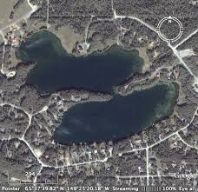
Regs - conversion
11 AAC 95.200. Land use conversion. (a) The requirements of 11 AAC 95.260 - 11 AAC 95.390 do not apply if a landowner intends to convert forest land to another use within five years after timber harvest and the land is converted or in the process of conversion within 5 years.
(b) If, 5 years after timber harvest, the land is not converted or actively in the process of conversion, a landowner shall meet the reforestation requirements of 11 AAC 95.375 - 11 AAC 95.390 within 3 years.
11 AAC 95.900 (13) "conversion" means a bona fide land use conversion to a use that is incompatible with timber growing;
www.asf@alaska.edu

Slide 7
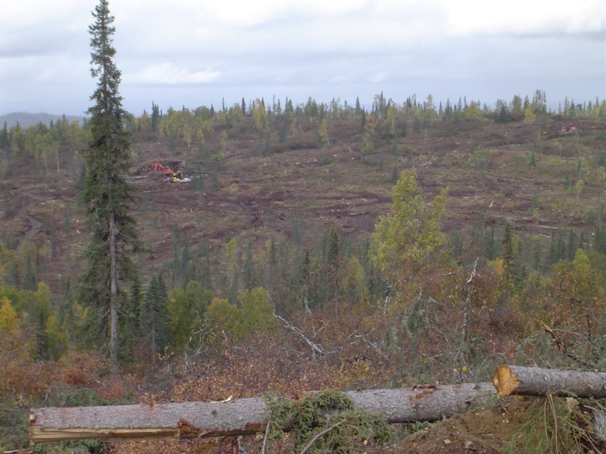
Statute: FRPA – all non-federal lands
Sec. 41.17.060. Regulatory and administrative standards. (b) With respect to state, municipal, and private forest land, the following standards apply: […]
(4) to the fullest extent practicable, harvested forest land shall be reforested, naturally or artificially, so as to result in a sustained yield of merchantable timber from that land; if artificial planting is required, silviculturally acceptable seedlings must first be available for planting at an economically fair price in the state; […]
Montana Cr. Native Assn. harvesting

Slide 8
Statute: FRPA – Public lands
(c) With respect to state and municipal forest land only, the following standards also apply: […]
(4) timber harvesting is limited to areas where data and information demonstrate that natural or artificial reforestation techniques will result in the production of a sustained yield of merchantable timber from that area;
(5) there may not be significant impairment of the productivity of the land and water with respect to renewable resources;

Slide 9
Regs - Purpose
FRPA REGULATIONS
11 AAC 95.185. Purpose and relationship to other laws. (a) This chapter implements and interprets AS 41.17 (Forest Resources and Practices). For land outside riparian areas, the purpose of this chapter is to provide protection of important public resources, maintain an economically viable timber industry, prevent or minimize significant adverse effects of soil erosion and mass wasting on water quality and fish habitat, and ensure reforestation to the fullest extent practical, taking into account the economic feasibility of timber operations. […]

Slide 10
Regs - definitions
11 AAC 95.900. Definitions. In this chapter, unless the context specifically states otherwise:
(11) "commercial tree species" means any species that is capable of producing a merchantable stand of timber on a par­ticular site or is being grown as part of a Christmas tree or ornamental tree-growing operation;
(86) "timber" means merchantable trees, standing or down, of a commercial tree species;

Slide 11
Regs – definitions, cont.
(63) "reforest" means the successful reestablishment of commercial tree species following harvest;
(67) "residual trees" means commercial tree species left standing in a harvest unit or other specified area after comple­tion of harvest or, for purposes of 11 AAC 95.375, immediately before beginning reforestation activities in that unit or area;
(71) "sapling" means a live tree 1.0 inch to 5.0 inches in DBH;
(73) "seedling" means a live tree less than 1.0 inches in DBH, or under 10 feet tall;

Slide 12
Regs - DPO
11 AAC 95.220. Detailed plan of operations. (a) Before beginning an operation on forest land, the operator shall file a detailed plan of operations with the state forester at the area office of the division with jurisdiction over the geographic area in which the operations will occur. A detailed plan of operations must be submitted on a form provided by the division and must include the following information: […]
(10) reforestation and site preparation methods;

Slide 13
Regs - DPO
11 AAC 95.375. Reforestation requirement. (a) The reforestation plan included in the detailed plan of operations must identify the preferred target species, regeneration technique, and site preparation method that the land owner will use to accomplish the reforestation requirements identified in this section.

Slide 14
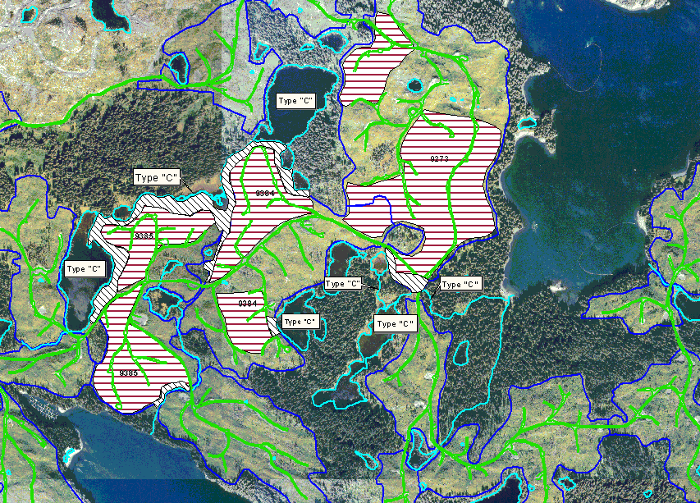
Regs - Planning
11 AAC 95.340. Harvest unit planning and design. […] (b) A harvest unit must be designed so that felling, bucking, yarding, skidding, and reforestation can be accomplished in compliance with AS 41.17 and this chapter.

Slide 15
Regs – Material sites
11 AAC 95.325. Material extraction and disposal sites.
(d) An operator shall rehabilitate a material extraction site or a soil disposal site after the material source is exhausted or abandoned, or operations at the disposal site are completed. Within the first growing season after abandonment of an extraction site or completion of disposal operations, an operator shall
(1) remove and place in a stable location all material that has potential for entering surface or standing waters, or that would prevent reforestation of an otherwise plantable area;

Slide 16
Regs – time and stocking
11 AAC 95.375 (d) Reforestation must be achieved within five years after harvest in Region I and seven years after harvest in Region II and Region III as follows:
(2) in Region II or Region III, the number of vigorous, undam­aged, and well distributed seedlings of commercial tree species must average a minimum of 450 trees per acre and must have survived on site for a minimum of two years;
(3) in all regions adequate reforestation means a combination of seedlings and residual trees that will meet the standards set out in this subsection and in (b) of this section; and

Slide 17
Regs – stocking, cont.
11 AAC 95.375 (b)(4) in Region II or Region III, vigorous, well-distributed residual commercial trees free from significant damage meet or exceed the following standards, or a combination of trees and seedlings approved by the division, meet the following standards:
Average DBH of Remaining Stand – Inches | Minimum Stocking Standard (in trees per acre)
Greater than 9 | 120
6 to 8 | 170
1 to 5 | 200

Slide 18
Regs –stocking distribution
11 AAC 95.375 (d) Reforestation must be achieved within five years after harvest in Region I and seven years after harvest in Region II and Region III as follows:
(4) no more than 10 % of the harvest area or contiguous areas may be below the stocking levels as set out in (1) or (2) of this subsec­tion.

Slide 19
Regs – variations, cont.
11 AAC 95.375 (c) In areas within Region II or III where the natural stocking of commercial trees is below the minimum standards in (b)(4) before harvest, the division will consider a variation from the stocking levels required in (d) of this section.

Slide 20
Regs - extensions
11 AAC 95.375(e) [DOF] will, in its discretion, grant a reasonable extension of time to comply with the requirements of this section if planting or seeding fails or cannot be completed because of circumstances beyond the control of the forest landowner. To be eligible for a time extension the forest landowner must notify the division within 30 days of becoming aware of the circumstances requiring an exten­sion. The written request must identify the reason for the extension and give a reasonable estimation of the time needed to achieve adequate reforestation in accordance with this section.

Slide 21
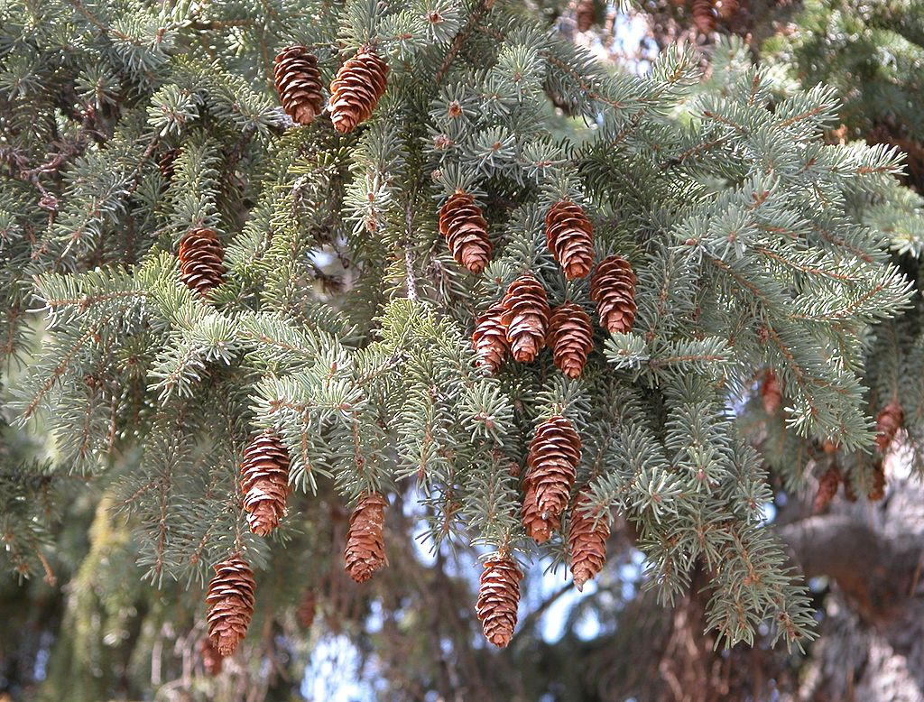
Regs – seed source
11 AAC 95.375 (f) Seeds used for reforestation must be from a similar latitude, climatic area, and elevation as the harvested area, unless otherwise approved by the division.
Wikipedia

Slide 22
Regs – natural regeneration
11 AAC 95.380. Natural regeneration. (a) If a forest landowner in Region II or III intends to rely on natural regeneration for reforestation, the forest landowner shall ensure a seed source of well-formed, vigorous trees of commercial tree species. The seed source must be capable of distributing an adequate amount of seed throughout the harvest area to meet the reforestation requirements set out in 11 AAC 95.375(d). A forest landowner may not harvest the seed source identified for natural regeneration until the division has received a regeneration report showing that the harvest area has met the reforestation requirements set out in 11 AAC 95.375.

Slide 23
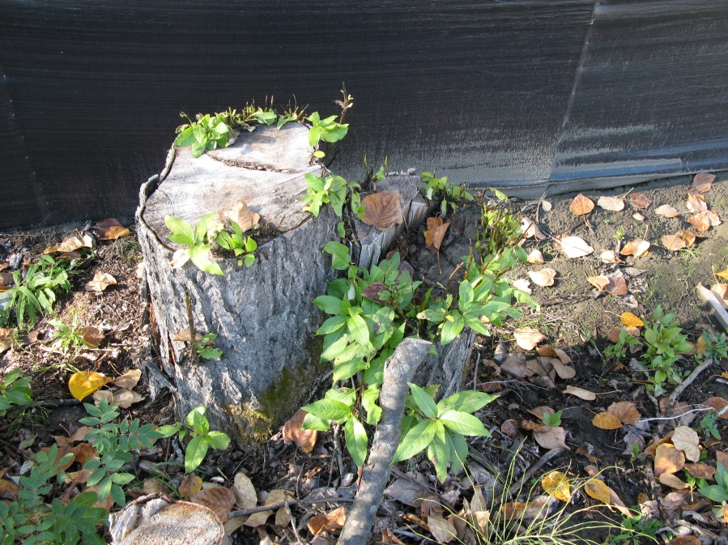
Regs – natural regeneration, cont.
11 AAC 95.380 (b) If a forest landowner intends to rely on vegetative reproduction for reforestation, the harvest area must contain aspen, balsam poplar, western black cottonwood, red alder, or paper birch in sufficient distribution and condition to meet the reforestation requirements set out in 11 AAC 95.375.
Balsam poplar sprouts in Susitna valley - Jeff Graham

Slide 24
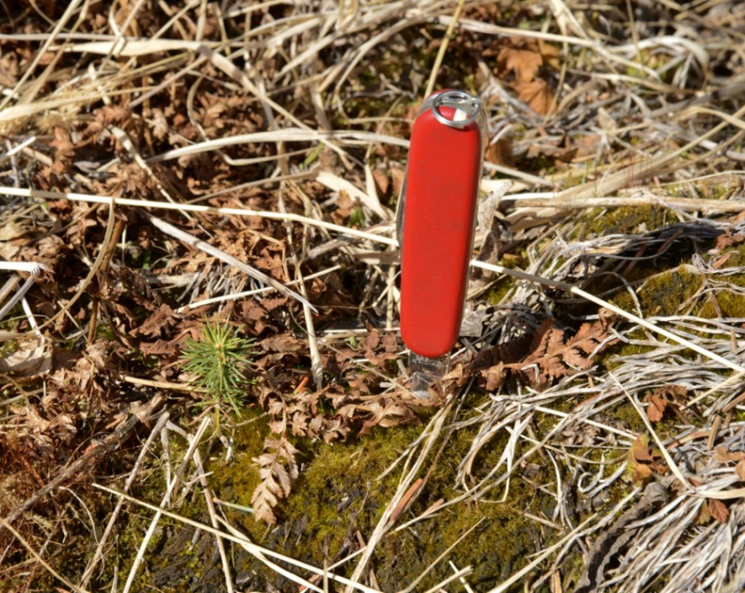
Regs – Regen surveys
11 AAC 95.385. Regeneration survey and report. (a) A forest landowner in Region II or III shall conduct a regeneration survey and file a regeneration report with the division.
A regeneration survey must be conducted in a manner acceptable to the division.
Volunteer seedling – Kenai Peninsula W. Wahrenbrock

Slide 25
Regs – regeneration report
11 AAC 95.385 (a), cont. In an area reforested by natural regeneration, planting, or artificial seeding, a regeneration report shall be submitted within
(2) seven years after the timber harvest in Region II or III.
(b) DOF will review a regeneration report within 30 days and will inform the forest landowner if field verification is planned. Field verification must occur within 12 months after receipt of the regeneration report. If the report or field verification shows that the reforestation requirements of 11 AAC 95.375 have not been met, the division will direct the forest landowner to correct the deficien­cies according to a reasonable timeline set by the division.

Slide 26
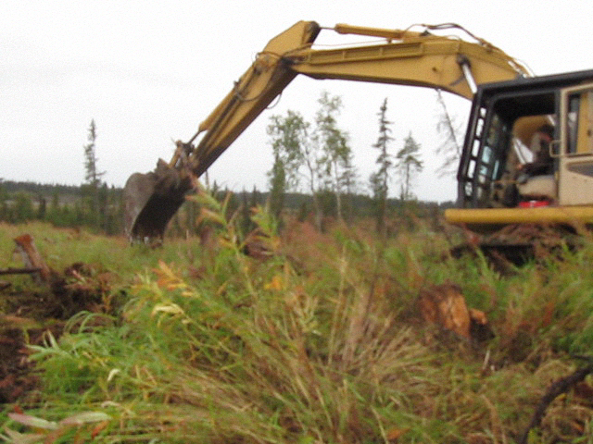
Regs – site preparation
11 AAC 95.390. Site preparation. If site preparation for reforestation is necessary, a forest land owner
(1) shall incorporate reasonable measures to protect residual trees intended to be retained;
(2) shall avoid degradation of surface water quality;
(3) may not cause significant harm to fish habitat; and
(4) shall minimize the use of heavy equipment where soil compaction or impacts to drainage will cause degradation of site productivity.
Kenai site prep John Winters

Slide 27
Clearing of spruce trees
11 AAC 95.195 (a) […] to minimize the spread of destructive forest insects and reduce the risk of wildfire, a landowner in Region II or III shall perform one or more of the practices identified in (b) of this section within one year, unless notified by the division, of clearing spruce trees, other than black spruce. [Region I…]
(b) The following practices may be performed to comply with (a) of this section:
(1) spruce trees or limbs greater than five inches in diameter may be disposed of by manufacturing into cants, lumber, houselogs, chips, or firewood;
(2) spruce trees or limbs greater than five inches in diameter may be disposed of by burning, subject to applicable regulations;
(3) downed and removed spruce trees or limbs greater than five inches in diameter may be treated or stored in an appropriate manner, if they are not burned, manufactured, or otherwise used in a way that will prevent the spread of bark beetles;
(4) spruce limbs greater than five inches in diameter may be dried by uniform scattering in areas open to sunshine if they are not burned or chemically treated.
(c) The division will, in its discretion, approve other methods for disposal or treatment of downed spruce trees to minimize the spread of bark beetles or reduce the risk of wildfire.
(d) If notified by the division, a landowner must provide a slash management plan that addresses the requirements of this section.
Notes:
S&TC looked at interaction of reforestation with I&D; outbreaks can affect reforestation success (e.g., by killing seed trees); no change needed to this regulations

Slide 28
Regs - exemptions
11 AAC 95.375 (b) A landowner shall reforest harvested forest land to the fullest extent practicable unless:
(1) the land will be converted to another use in accordance with 11 AAC 95.200;
(2) the stand is significantly composed of insect and disease-killed, fire killed, wind- thrown, or fatally damaged trees; or

Slide 29
Regs – exemption process
11 AAC 95.375 (g) To apply for an exemption from reforestation requirements under (b)(2) of this section, a landowner must
request an exemption in the reforestation section of a DPO or a change in operations and must demonstrate that the affected stand is significantly composed of insect and disease-killed, fire killed, wind thrown, or fatally damaged trees.
If required by DOF, the request must include a description of the sampling procedure, the sampling data, and a data summary. The data summary must show the number of commercial trees per acre that are dead or fatally damaged, and the percentage of commercial trees in the stand that are dead or fatally damaged.

Slide 30
Regs – exemption process, cont.
11 AAC 95.375 (g)
Sample plots must be located without bias throughout the affected stand. For stands 1,000 acres or less, the minimum sample density is 10 plots per 100 acres. For stands greater than 1,000 acres, the minimum sample density is six plots per 100 acres. Fewer plots are acceptable if the sample standard error is less than 10 percent of the mean.
Either fixed diameter or variable plot sampling methods are acceptable. Sample plots must average approximately at least five sample trees of commercial value. Trees must be recorded by diameter class as either dead, damaged by insects, disease, fire, or wind, or not impacted. The division may accept other documentation or field evidence in lieu of sampling in cases where the extent of damage is obvious.

Slide 31
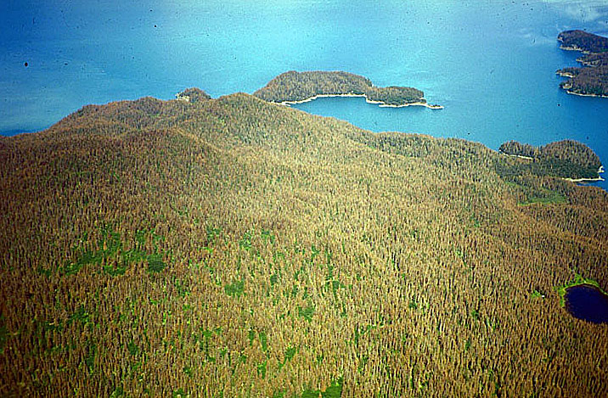
Regs – exemption process, cont.
11 AAC 95.375 (h) Following receipt of the exemption request, the division may inspect the site to confirm the information submitted before determining whether the stand is significantly composed of insect and disease-killed, fire killed, wind thrown, or fatally damaged trees. The division will make this determination as part of the review of the DPO or change in operations. In areas exempted from refor- estation requirements, the land owner and operator shall protect existing reproduction from logging damage where feasible.
Spruce bark beetle infestation – Kenai Peninsula

Slide 32
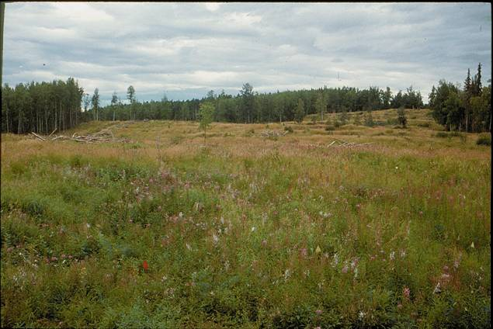
Questions?
USFS Andrew Youngblood
Change to Scale of harvesting PPT

