Slide 1
2017 NATIONAL LOGISTICS WEBINAR
NATIONAL INTERAGENCY SUPPORT CACHE PRESENTATION

Slide 2
2017 TOPICS
NATIONAL INTERAGENCY SUPPORT CACHE SYSTEM
REPORTS, CATALOG, HANDBOOKS & FORMS UPDATES
INCIDENT REPLACEMENT REQUISTION (IRR) INSTRUCTIONS
INCIDENT TO CACHE RESOURCE ORDER SPREADSHEET
NEW NFES ITEMS AND UPDATES
NFES KIT CHANGES
NISCC ISSUES & CONCERNS

Slide 3
NATIONAL INTERAGENCY SUPPORT CACHE SYSTEM
The NISC’s are made up of 15 caches in strategic locations throughout the United States.
Northern Rockies Area Incident Support Cache (NRK) - Missoula, MT
Billings Incident Support Cache (BFK) - Billings, MT
Coeur d’Alene Incident Support Cache (CDK) - Coeur d’Alene, ID
Rocky Mountain Area Incident Support Cache (RMK) - Denver, CO
Southwest Area Prescott Incident Support Cache (PFK) - Prescott, AZ
Southwest Area Silver City Incident Support Cache (SFK) – Silver City, NM
Northern California Incident Support Cache (NCK) - Redding, CA
Southern California Incident Support Cache (LSK) - Ontario, CA
Great Basin Area Incident Support Cache (GBK) - Boise, ID
Northwest Area Incident Support Cache (NWK) - Redmond, OR
La Grande Incident Support Cache (LGK) – La Grande, OR
Wenatchee Incident Support Cache, Wenatchee WA
Southern Area Incident Support Cache (SAK) - London, KY
Eastern Area Incident Support Cache (NEK) - Grand Rapids, MN
Alaska Incident Support Cache (AKK) - Ft. Wainwright, AK
The caches are operated under the direction of federal and state agencies, including the US Forest Service; Bureau of Land Management and various states including Alaska, Minnesota and Idaho.

Slide 4
The 15 caches are connected by the common inventory software system (ICBS) Interagency Cache Business System that is interfaced with the Dispatch (ROSS) Resource Ordering & Status System. This allows the electronic transfer of data from Supply and Equipment orders between the two systems. This allows individual cache managers to access and share inventory information electronically, enabling an efficient transfer of critical supplies and equipment between areas less affected by incidents to those in critical need. This, in conjunction with support from the newly acquired DLA Wildland Fire Equipment program and those commercial vendors supporting incident related programs make up the backbone of the incident supply system.
Each cache is located within an area controlled by a (GACC) Geographic Area Coordination Center. Cache managers work with the GACC’s to manage the storage and distribution of communication systems and cache vans within their areas.

Slide 5
REPORTS & HANDBOOK UPDATES
ICBS-R ENTERPRISE INCIDENT SUMMARY & LOSS USE REPORT
Provides overall status of incident issued & returned supplies
Available upon request from supporting cache
Final report sent to hosting agency upon completion of refurbishment
NFES 0362 CATALOG - PMS 449-1, NWCG NFES - CATALOG PART 1: FIRE SUPPLIES & EQUIPMENT
2017 hard copy and online version available late spring/early summer
https://www.nwcg.gov/catalogs-ordering-quicklinks
Bar code section will be removed from hard copy and available online as separate publication
Cache manager’s recommended adding NSN’s back to hard copy for 2017
CM’s recommended adding pictures back to hard copy for 2018. Picture copy may only be available as on-line version.
NFES 1885 – GUIDE, PMS510 - INTERAGENCY HELICOPTER OPERATIONS (2013)
ONLY available on the NWCG website https://www.nwcg.gov/publications
Hard copies removed from 0520 & 0660 kits
NFES 2160 HANDBOOK, PMS902 - INTERAGENCY INCIDENT BUSINESS MANAGEMENT (2016)
Available April 2016 or online at https://www.nwcg.gov/publications

Slide 6
UPDATES/NEW STOCKED FORMS
UPDATES
NFES # DESCRIPTION U/I NOTES
000866 FORM, OF-288 – INCIDENT TIME REPORT (2/16) PG GSA ADV/DOD EMALL http://www.gsa.gov/portal/forms/download/242971 NSN 7540-01-124-7633
001173 VEHICLE/HEAVY EQUIPMENT PRE-USE INSPECTION CHECKLIST (2/16) PG GSA ADV/DOD EMALL
NSN 7540-01-120-0607
NEW
NFES # DESCRIPTION U/I NOTES
002113 FORM – NWCG-IBC TEST, COMMERCIAL RENTAL/SERVICE ENVELOPE (1/2014) PG NFES 0390 FINANCE KIT
002114 FORM – NWCG-IBC TEST, BUYING TEAM INCIDENT WAYBILL (1/2014) PG

Slide 10
INSTRUCTIONS FOR NFES INCIDENT REPLACEMENT TYPE 1 & 2 INCIDENTS
The incident Supply Unit Leader (SPUL) will be responsible for handling incident replacement requisitions when a Type I or Type II incident management team is assigned. The SPUL approves replacement requests based on Engine Accountability sheets or other fire equipment inventory documents approved by the requesting resource's home unit. The use of the Incident Replacement Requisition Form (OF-315) is requested.
If equipment and supplies are available at the incident for replacement, the request is filled at the incident supply unit.
If equipment and supplies are unavailable at the incident for replacement, AND the requesting resource is not being immediately demobilized, the Supply Unit will place a resource order for needed items through appropriate channels to the servicing fire cache. The order will be shipped to the incident and replacement will take place at the Supply Unit.
If equipment and supplies are unavailable at the incident for replacement, AND the requesting resource is being demobilized, an Incident Replacement Requisition will be completed by the Supply Unit and forwarded to the incident servicing cache. The servicing cache will then determine if the order should be forwarded on to the requesting resources geographic area cache for delivery.
Authorized approvals and signatures MUST be included on the requisition. For Type I and II incidents, these approvals are limited to: Incident Supply Unit Leader, Logistics Section Chief, Support Branch Director, Incident Commander or Agency Administrator or Representative.

Slide 11
INSTRUCTIONS FOR NFES INCIDENT REPLACEMENT TYPE 3 & 4 INCIDENTS
The hosting unit agency administrator or representative, such as the Fire Management Officer, will be responsible for handling incident replacement requisitions on Type III and IV incidents. The agency representative approves replacement requests based on Engine Accountability sheets or other fire equipment inventory documents approved by the requesting resource's home unit.
If equipment and supplies are available at the incident for replacement, the request is filled at the incident host unit.
If equipment and supplies are unavailable at the incident for replacement, AND the requesting resource is not being immediately demobilized, the hosting unit will place a resource order for needed items through appropriate dispatch channels to be inputted into the ROSS/ICBS interface to the servicing fire cache. The order will be shipped to the incident and replacement will take place at the host unit.
If equipment and supplies are unavailable at the incident for replacement, AND the requesting resource is being demobilized, an Incident Replacement Requisition will be completed by the host unit and forwarded to the local dispatch unit for input into the ROSS/ICBS interface and sent to the servicing cache. The servicing cache will then forward to the requesting resources geographic area cache if applicable.
Type 3 and 4 incident approvals are limited to the Agency Administrator or Representative (i.e., Fire Management Officer).

Slide 12
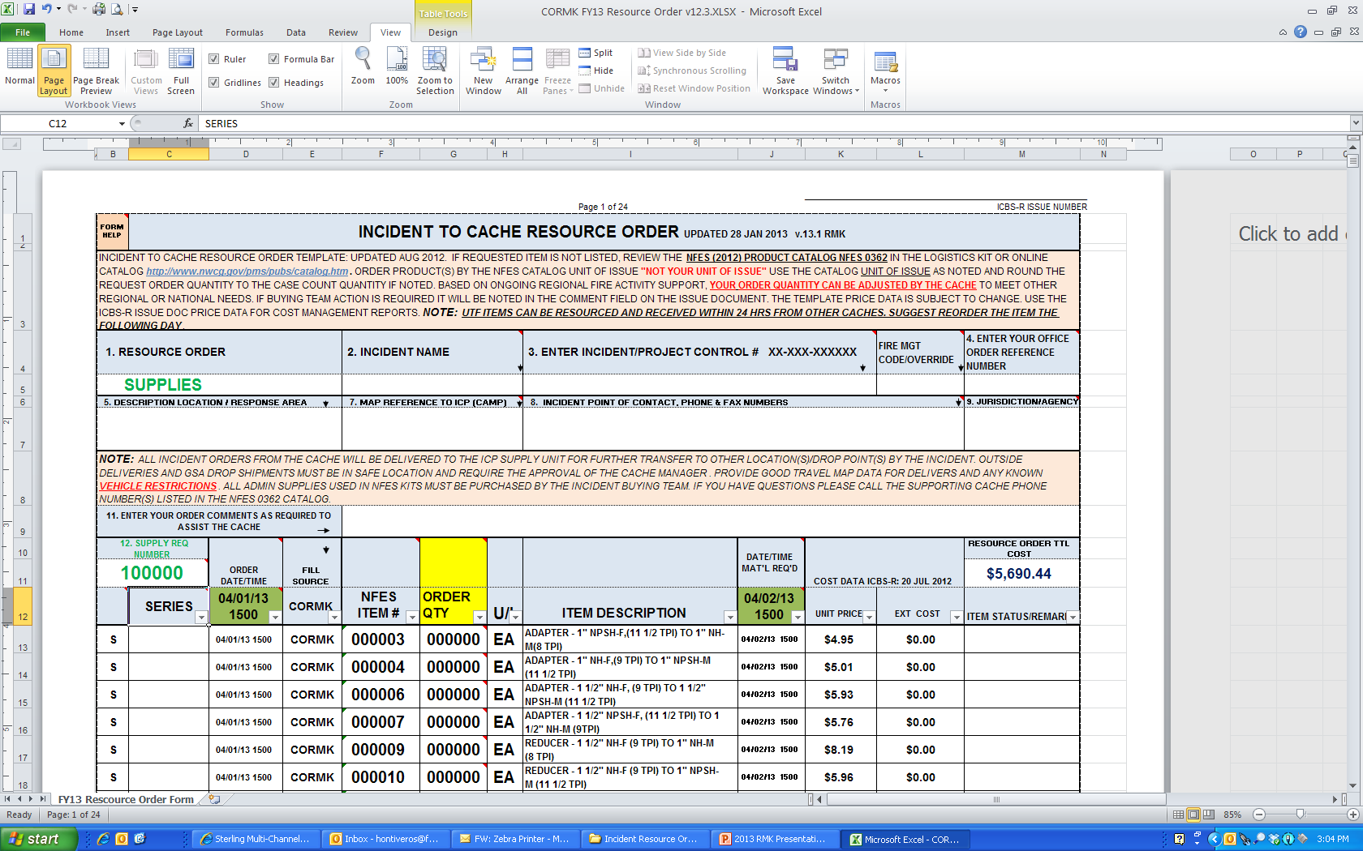
INCIDENT TO CACHE RESOURCE ORDER

Slide 13
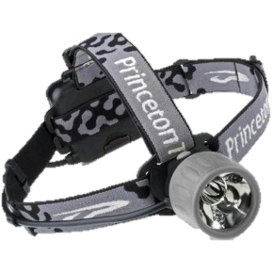
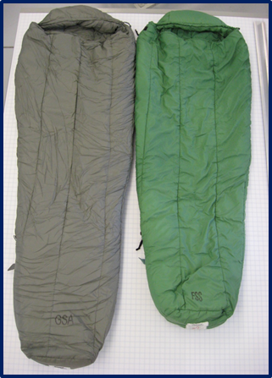
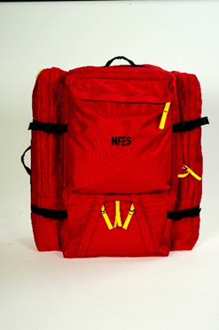
NEW NFES ITEMS AND UPDATES
New LED Headlamp NFES 000718
Available at all caches
New Cold Wx Sleeping Bag NFES 000128
Available at NCK, RMK, GBK, NEK and NRK
NFES 0022 still available at all caches
New Personal Gear Bag M-2014 NFES 0679
New features consist of two separate compartments
for tent & sleeping pad
Available to NISC’s through DLA early summer
NFES 1855 Old style personal gear bag will remain
available from all NISC’s

Slide 14
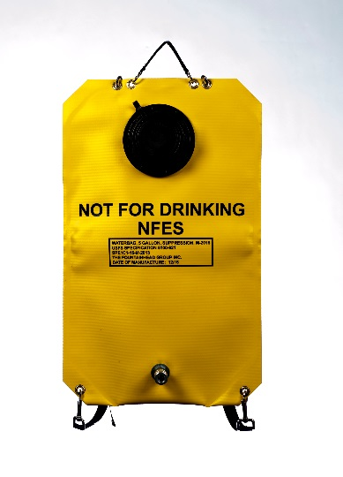
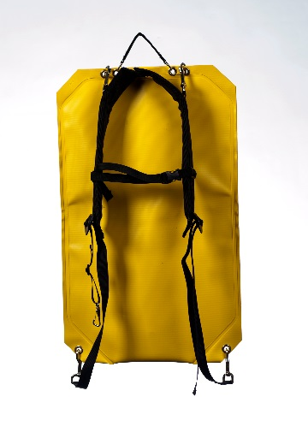
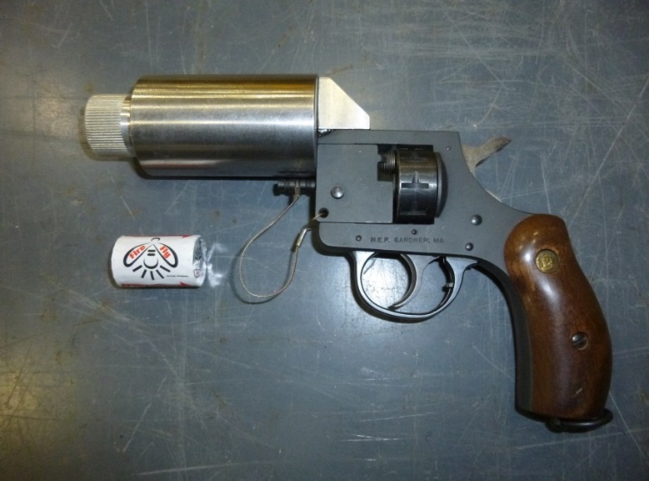
NEW NFES ITEMS AND UPDATES CONT.
Backpack Pump NFES 1149
New style bladder will be replacing liner style bladder
Trombone pump assembly will remain the same.
Old style bag will remain in system and
will be phased out through attrition
Fire Flare (Firepoint Products)
New fire flare tested by MTDC in 2015
NFES 0715 is no longer available

Slide 15
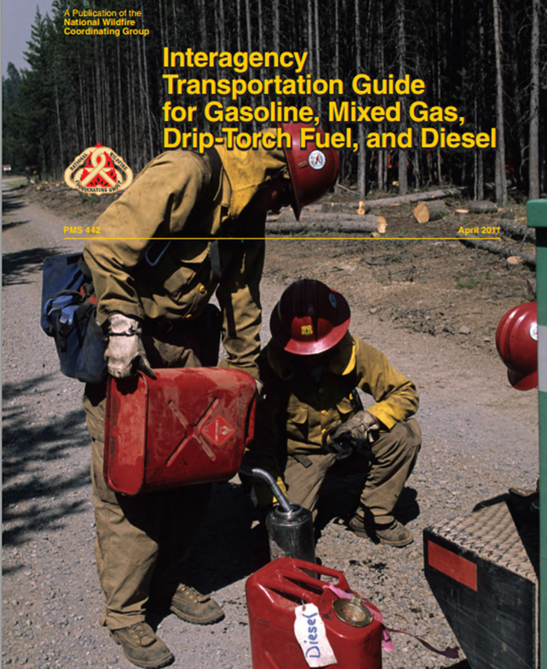
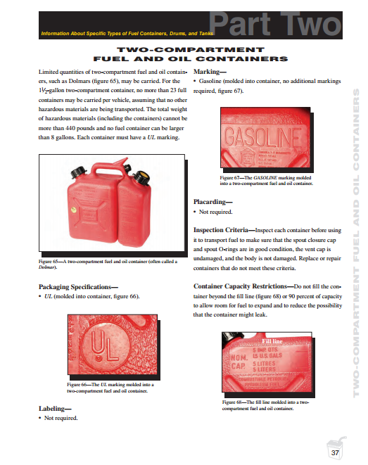
Dolmar OSHA Compliance
OSHA requires: Nationally Recognized Testing Laboratory (NRTL) such as Underwriter’s Laboratories (UL) to test to ASTM F852 standard.
Estimate as many of the 10,000 in our system are not UL tested/approved.
Draft supplemental standard reviewed by ETC/RMC.
Steve Schlientz, USFS Director of Safety and Occupation Health submitting request for supplemental standard to OSHA.
Re-created “geysering” in lab setting at SDTDC.

Slide 16
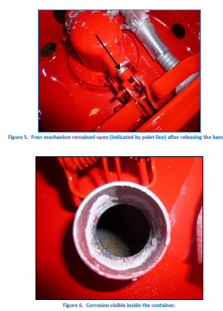
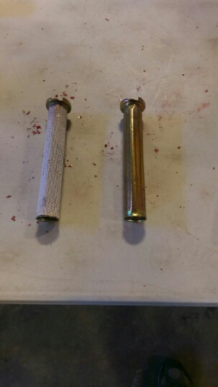
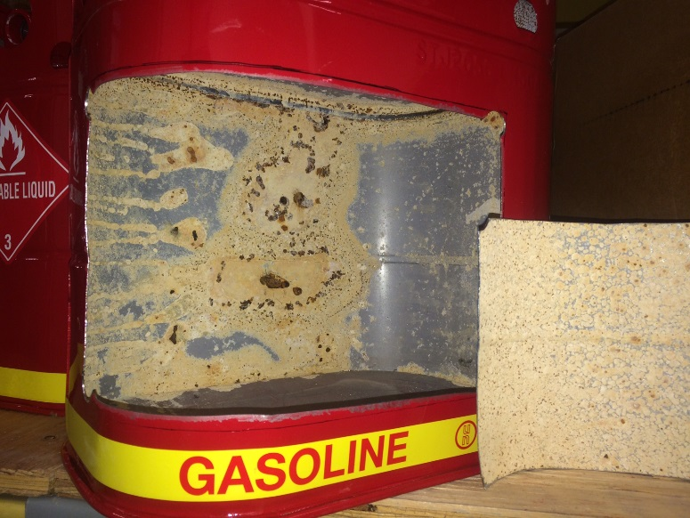
Safety Fuel Can Quality Issues
Major Quality Issues. ( Estimate 75%+ of RMK’s Cans)
Finalized a Corrective Action Plan. 12 issues:
Changing zinc plating and chromate sealer spark arrestors.
Spraying rust inhibitor on inside of cans and inserting silica gel packs in cans
Working with cache system to investigate “Jerry Can Style” containers.
Investigating acceptability of plastic Jerry Cans. Reviewing manf. info. static build up not an issue on their radar.
No “magic bullet fuel” container that meets all regulations and requirements, all have trade-offs.
Shawn preparing to have discussion around next steps and future options.

Slide 17
2-cycle oil
000341 – 1 qt.
003444 – 2.6 oz.

Slide 18
HOSE ROLLER
000633 - electric
000665 – gasoline
SDTDC & NISC Tasked to develop new hose roller

Slide 19
Pulaski Update
42 inch Fiberglass Handle
10 NUPLA Prototypes being built
To be field-tested
Drafting Additions to Refurbishment Standards
Requesting NFES number
Replacement handles
Long-handled Pulaski units
Box
Develop recommendations for implementation strategy

Slide 20
2017 NFES KIT CHANGES
1050 Kit, BELT WEATHER
Removal of following item:
NFES 1178 - FORM,B-O-6A - HUMIDITY & DEW POINT TABLE,(5/72) 1 EA
NFES 1179 - FORM,B-O-6B - HUMIDITY & DEW POINT TABLE,(5/72) 1 EA
NFES 1182 - FORM,B-O-6C - HUMIDITY & DEW POINT TABLE,(5/72) 1 EA
NFES 1185 - FORM,B-O-6D - HUMIDITY & DEW POINT TABLE,(5/72) 1 EA
NFES 2155 - FORM,B-O-6E - HUMIDITY & DEW POINT TABLE,(5/72) 1 EA
Addition of following item:
NFES 1177 - FORM, BUNDLE, B-O-6(A-E) - HUMIDITY & DEW POINT TABLES 1 EA
0340 Kit, CHAINSAW
Addition of following item:
NFES 0078 – CHAPS, 36” LONG 1 PR
Quantity change of following item:
NFES 1027 – EARPLUGS, FOAM, DISPOSABLE 10 -> 20 PG
8606 Kit, PUMP, PORTABLE, LIGHTWEIGHT, 4 CYCLE &
0670 Kit, PUMP, PORTABLE, LIGHTWEIGHT, 2 CYCLE
Removal of following item:
NFES 0272 – VALVE, GATED WYE ¾” ZINC 2 EA
NFES 0738 – VALVE, SHUT OFF ¾’ ZINC 2 EA
Addition of following item:
NFES 0835 – VALVE, SHUT OFF ¾’ BRASS 2 EA
NFES 0904 – VALVE, GATED WYE ¾” BRASS 2 EA
Quantity change of following item:
NFES 1027 – EARPLUGS, FOAM, DISPOSABLE 10 -> 20 PG

Slide 21
2017 NFES KIT CHANGES Continued…
0760 Kit, OFFICE SUPPLIES
Removal of following items:
NFES 0671 – CD-ROM - BLANK,W/JEWEL CASE 10 EA
NFES 0770 – TAPE - MASKING, 1" 2 RO
Addition of following item:
NFES 9498 – FLASHDRIVE - USB (16 GB OR GREATER) 5 EA
NFES 0763 – TAPE - PAINTERS, BLUE, 2” 4 RO
1060 Kit, ACCESSORY, VOLUME PUMP
Removal of following items:
NFES 0651 – OIL - SAE 30 WT 2 QT
Quantity change of following item:
NFES 1027 – EARPLUGS - FOAM, DISPOSABLE 10 -> 20 PG
Addition of following item:
NFES 7613 – OIL - SAE 10-30 WT 2 QT
0390 Kit, FINANCE
Quantity change of following item:
NFES 1051 – PAD - POST-IT-NOTE, 3 X 3 10 -> 12 PD

Slide 22
2016 NFES KIT CHANGES
NFES 0390 - KIT, FINANCE SECTION
Item Removal
NFES 0862 - FORM, OF-294 – EMERGENCY EQUIPMENT RENTAL AGREEMENT
NFES 1576 - FORM, ICS-225 – INCIDENT PERSONNEL RATING
Item Quantity Changes
NFES 0420 - FORM, OF-304 – EMERGENCY EQUIPMENT FUEL AND OIL ISSUE 10 -> 5 PD
NFES 0422 - FORM, OF-305 – EMERGENCY EQUIPMENT RENTAL USE ENVELOPE 1 -> 2 PG
NFES 0790 - BOX – INTERFILE, LEGAL AND LETTER SIZE 1 -> 2 EA
NFES 0891 - FORM, SF-261 – CREW TIME REPORT 15 -> 25 BK
NFES 0866 - FORM, OF-288 – EMERGENCY FIREFIGHTER TIME REPORT 3-> 1 PG
NFES 0872 - FORM, OF-297 – EMERGENCY EQUIMENT SHIFT TICKET 15 -> 25 PD
NFES 1336 - FORM, ICS-213 – GENERAL MESSAGE 1 -> 2 PG
Item Additions
NFES 0447 - PENS, BLUE INK 36 EA
NFES 0766 - ENVELOPE PLAIN MANILLA 9-1/4 X 12” 50 EA
NFES 1051 - POST-IT NOTES 3” X 3” 10 PD
NFES 1039 - HIGHLIGHTERS, MIXED COLORS 1 SE
NFES 1286 - FORM, OF-315A – INCIDENT REPLACEMENT REQUISITION, CONT 1 PG
NFES 1300 - FORM, OF-315 – INCIDENT REPLACEMENT REQUISITION 1 PG
NFES 2113 - COMMERCIAL RENTAL/SERVICE ENVELOPE 2 PG

Slide 23
2016 NFES KIT CHANGES Continued…
NFES 0260 - KIT, PUMP TOOL ROLL, FIRE PORTABLE
Item Removal
NFES 2591 – GAUGE, FEELER
NFES 0261 – TOOL, CARB ADJ
NFES 0910 - KIT, LOGISTICS
Item Removal
NFES 0288 – CLOCK, DIGITAL, BATTERY OPERATED
NFES 0364 – ATLAS, ROAD, NORTH AMERICA
Item Additions
NFES 0420 - FORM, OF-304 EMERGENCY EQUIPMENT FUEL AND OIL ISSUE 6 PD
NFES 0422 - FORM, OF-305 EMERGENCY EQUIPMENT RENTAL USE ENVELOPE 1 PG
NFES 1040 - KIT, CRASH RESCUE
Item Quantity Changes
NFES 1281 – BLADE, HACKSAW 10 -> 5 EA

Slide 24
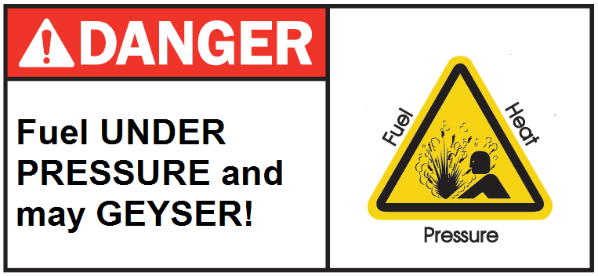
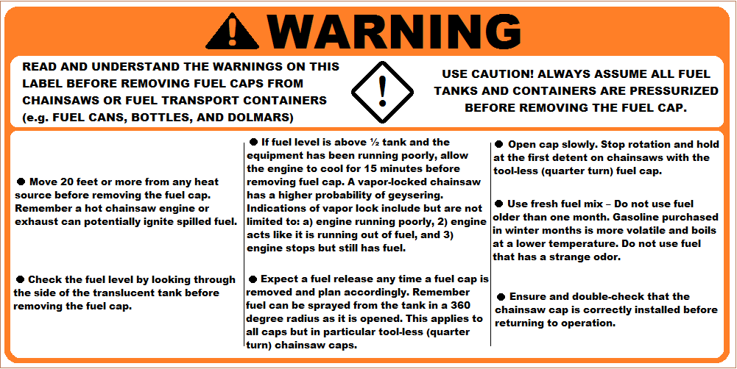
NFES KIT UPDATES
NATIONAL SMOKE MONITORING PROGRAM
Host – Rocky Mountain Interagency Support Cache
20 E-Sampler Kits and 4 E-Bam Kits (more E-Bam’s soon)
FUEL GEYSER WARNING Labels and Tags will now be seen on the following
Chainsaw Kit Carton
Chainsaws, Leaf Blowers and possibly Lightweight Pumps
Dolmars, Sig Bottles and Jerry Cans
NFES 0549 – KIT, SHELTER 20’ OCTOGON (YURTS)
National Kit Committee tasked with standardizing
and updating kit component list throughout NISC’s
Recommended additions;
Floor
Kit, High Wind Tie Down
Ramp, Double Door Entrance
Kit, Insulation
Convert single door kits to double door kits
Heater project tested in RM Region in 2016 and continued research by SDTDC
INTRODUCTION OF NFES 8753 – KIT, LEAF BLOWER IN SOUTHERN AREA
2017 Kit Updates also affect region specific kit due to stardard packaging of earplugs and transition to 10w-30 oil
Stihl Chainsaw recall (MS461/MS461R) – 338 NISC’s chainsaws were affected by this recall
2018 – Proposed changes to 0800 Planning Kit and 6051 Multi-Light Kit

Slide 25
ISSUES AND CONCERNS
Incident to Incident Transfer
National Fire Loss/Use percentages
Excessive loss of medical kit equipment at incidents.
Use of IMT pre-orders when taking over for an existing team.
Use of Cache Liaison and Cache Demob positions.
Are the NISC’s providing the following;
Good customer service
Good quality product
Are we carrying the right supplies & equipment you need
Are we providing efficient and timely deliveries
Are the functional kits meeting your needs

Slide 26
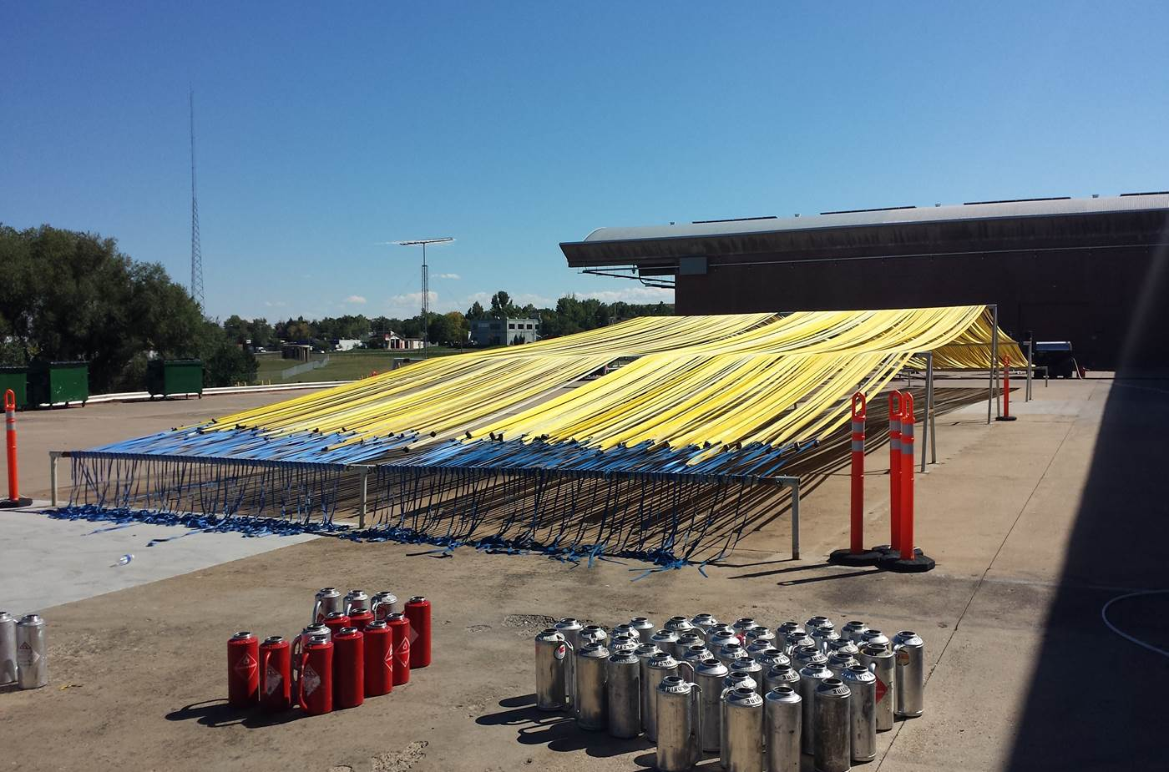
2015 NATIONAL LOGISTICS WEBINAR NATIONAL INTERAGENCY SUPPORT CACHE PRESENTATION
CONTACT INF0RMATION
MARCUS MEDINA
CHAIR, NATIONAL CACHE MANAGERS
ROCKY MOUNTAIN FIRE CACHE MANAGER
ROCKY MOUNTAIN INTERAGENCY SUPPORT CACHE
DENVER FEDERAL CENTER
BLDG 810, DORR N27
P.O. BOX 25507 (mail only)
LAKEWOOD, CO 80225
303-202-4943 OFFICE
928-642-4653 CELL
303-202-4965 FAX
mmedina@fs.fed.us

