Slide 1
National Equipment Program
Dave Haston
US Forest Service
Branch Chief, Equipment and Chemicals
National Interagency Fire Center

Slide 2
National Equipment Program
NWCG Governance:
Equipment Technology Committee (ETC)
National Fire Equipment System (NFES)
National Cache System
Agency Role:
National Equipment Program Manager
National Fire Chemical Program Manager
Policy and oversight of FS national cache system
Equipment Development (NTDP)

Slide 3
National T&D Program
One program, two locations
SDTDC was established in 1945 in Southern CA
MTDC was established in 1950 in Missoula MT
Work divided by expertise
Unique program in fire service
Notes:
MTDC – PPE like hard hats, gloves, nomex, fire shelters; ignition devices; chemical – retardent qualification
SDTDC – Waterhandling equipment like pumps, hose, appliances, hand tools; spark arrestors; air tanker qualifications for retardant drops
The Forest Service National Technology and Development Program provides Forest Service employees and partners with practical, science-based solutions to resource management challenges. The T&D program evaluates, designs, and develops new technologies to solve problems and deliver solutions.
Program areas include fire and aviation management, engineering (facilities, transportation, environmental), forest management, reforestation, nurseries, recreation, safety and health, forest health protection, watershed and air management, explosives, global positioning systems, posters and signs, and inventory and monitoring.

Slide 4
National Equipment Program
Cache coordinator (NISCC) – PL4/PL5
Equipment and supplies coordinated nationally
Cache to Cache orders
Cache Liaison

Slide 5
Considerations
Pre-Orders: Not the initial IMT
Cache support at elevated national PL’s:
2015
2016: Soberanes ($18M)
Significant percentage coming back RFI
System limitations (space, staffing)

Slide 6
Fire Loss
IIMBH Chapter 30
Forest Service Handbook – 5109.16
Terminology:
Old term: “Loss tolerance”
Implied some loss was acceptable

Slide 7
Fire Loss
FSH 5109.16:
The objective is no (zero) fire loss
A single instance of lost, damaged, or destroyed accountable, sensitive and trackable property needs to be documented and reported

Slide 8
Fire Loss
New Term: “Performance Threshold”
5109.16: Enforcement of fire loss/use rates and related procedures is the responsibility of the Forest Supervisor

Slide 9
Fire Loss
Fire Loss Performance Thresholds:
Accountable Property 10%
Durable Items 10%
Sensitive Property 10%
Trackable Property 10%
Consumable Goods 65% returned

Slide 10
Fire Loss - Actual
Excluding consumables
Type 1, 2 and reportable Type 3
2011 13%
2012 14%
2013 10%
2014 11%
2015 10%
2016 13%

Slide 11
Fire Loss
Forest Supervisor:
Account for lost or damaged equipment
Ensure reviews of fire loss/use rates are conducted
Establish follow-up action plan if thresholds are exceeded

Slide 12
How Can Logistics Help?
Don’t over-order/stockpile
Accountability
Document loss
Communicate w/servicing cache
Cache Demobilization Specialist (CDSP)
Backhaul

Slide 13
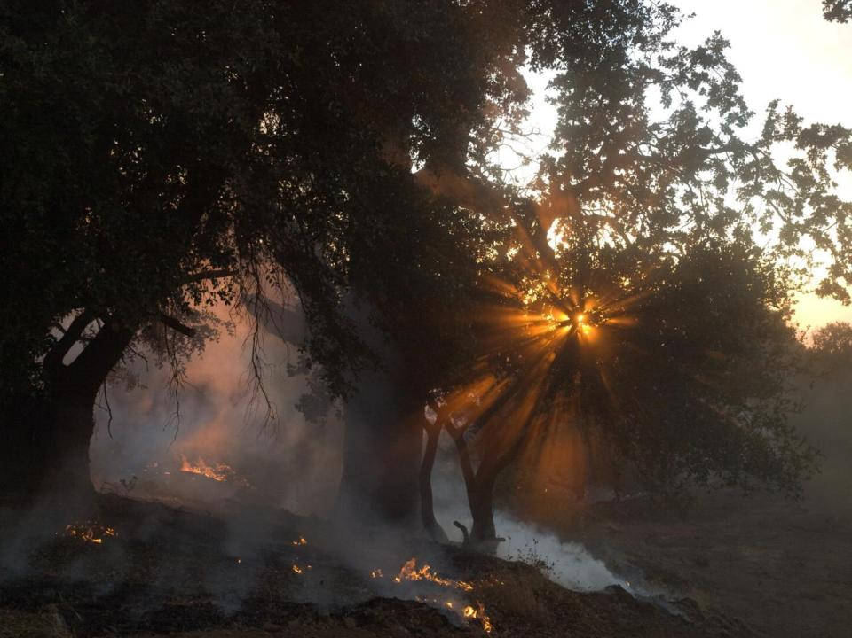
Questions
Contact Info:
Dave Haston
dhaston@fs.fed.us
(208)-484-7967

