Slide 1
National Logistics Webinar 2017
Satellite Services

Slide 2
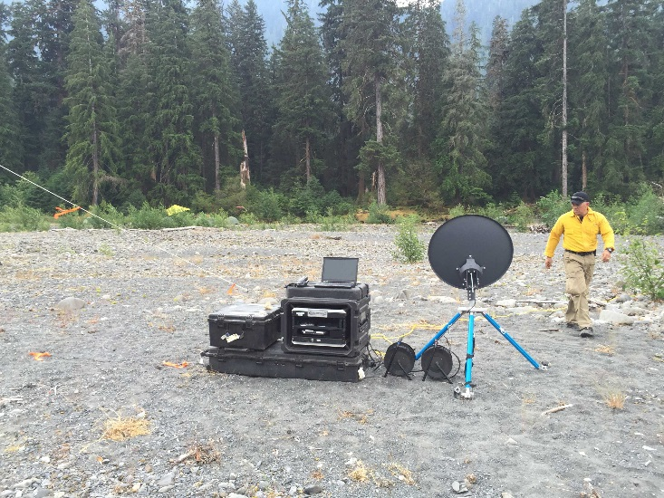
Ordering Satellite Services on Incidents
Background and Previous Use
GACC Agreements vs National Contracts
EERA Acquisitions
Lessons Learned-Contract requirements vs. what IMT wants/needs
Verizon Emergency Response Team Update

Slide 3
Background
Location of ICP and use of local Internet Service Providers (ISP)
Issues with filtered access (schools and other access points)
Greater complexity at remote ICP locations
Spike camps and multiple ICP locations
Currently, internet service is an option item with some support equipment
Facilitating fair and reasonable pricing via at-incident EERAs or commercial arrangements (DSL, cable, Satellite, etc.)

Slide 4
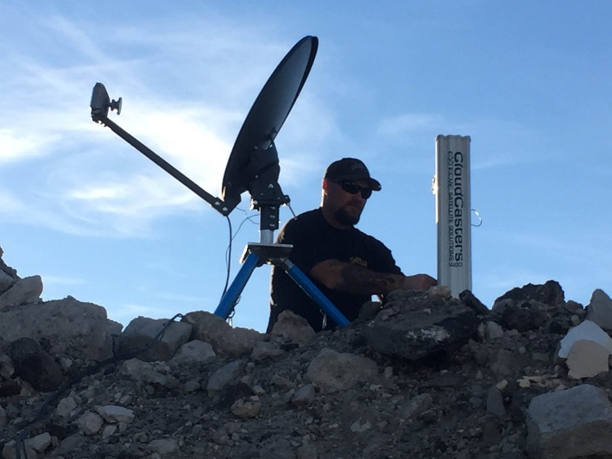
GACC Agreements vs National Contracts
Changes since last webinar
5 year contract in R-5 with two vendors (Knight Sky and CloudCasters)
R-6 will have a 3 year contract in the next 2 months.
These contracts can be utilized anywhere in the U.S.

Slide 5
GACC Agreements vs National Contracts
Current status of how regions are obtaining service
R-5 established contract
R-6 new contract / last season utilized EERA
R-4 will use R-5 contract or hire as commercial hire (LBI, CloudCasters, etc.)
R-3 is willing to use R-5 or R-6
R-2 Has used a season long EERA with DrillCom (All of R-2)
R-1/R-6 have acquired ViaSat systems (COMT’s manage)

Slide 6
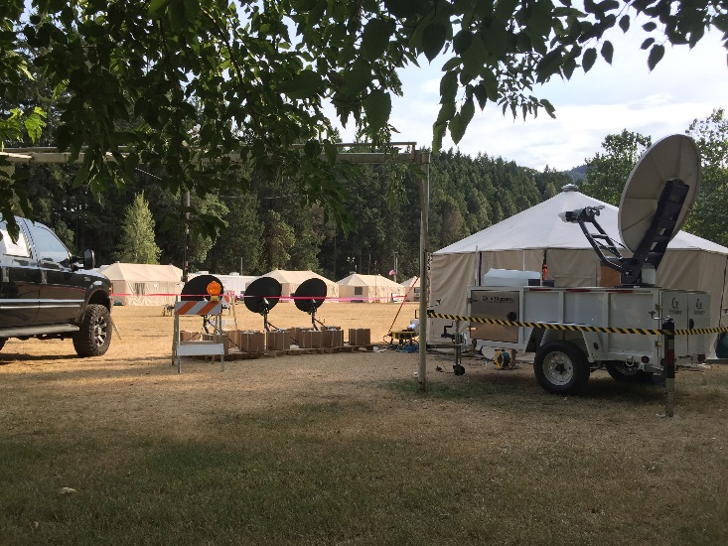
Lessons Learned
Contract requirements vs. What IMT wants/needs
Be specific in what you will need
KU vs KA type satellite bands
Speed/Bandwidth/Cost
Time till service, use of temporary services and costs associated
Remote services to remote sites reduced risk and provided cost savings

Slide 7
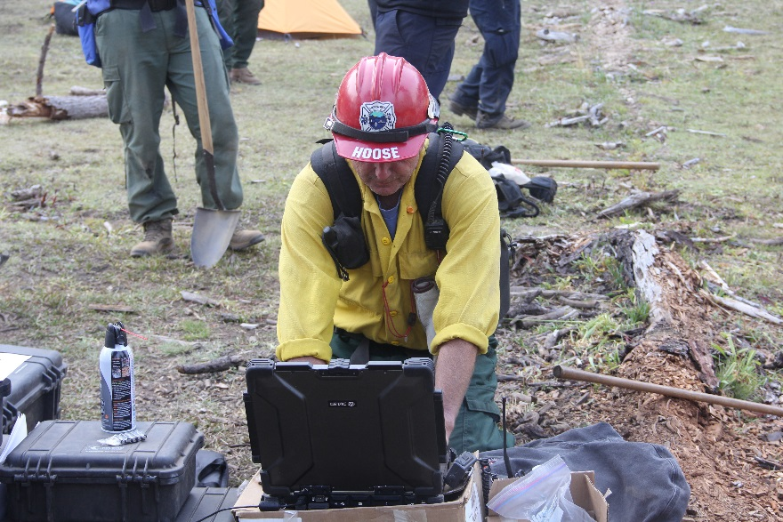
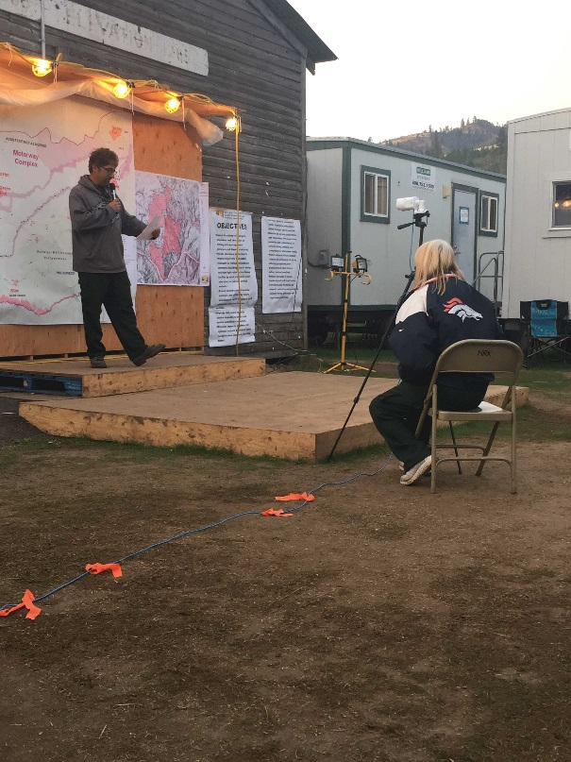
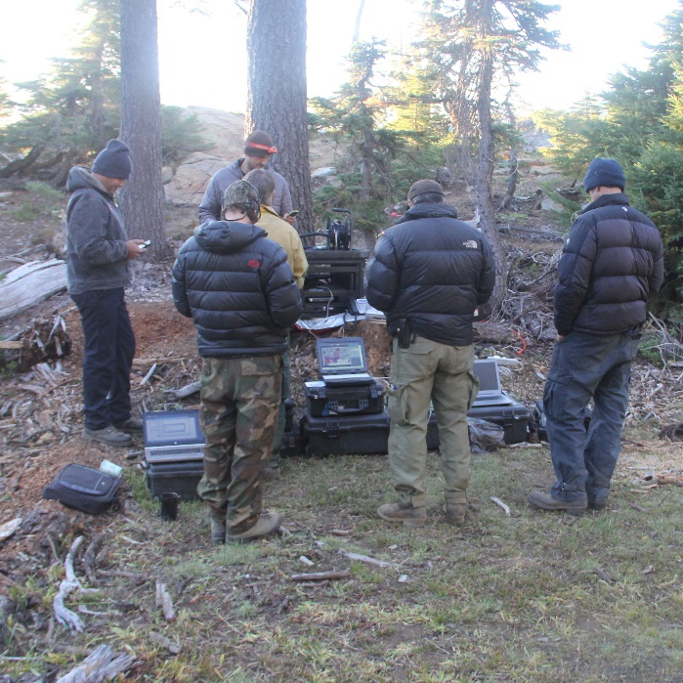
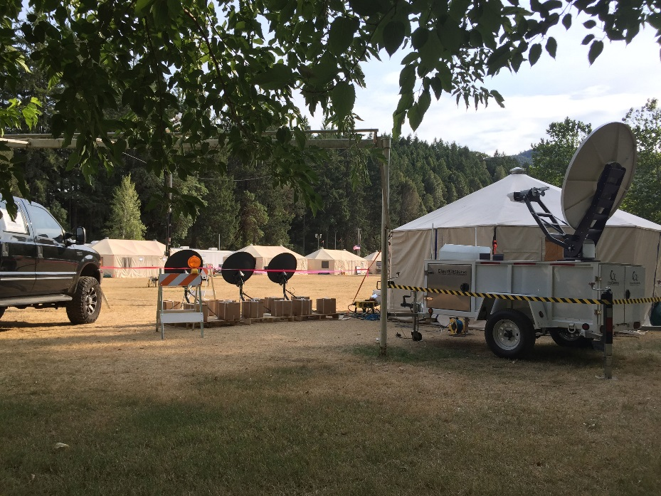
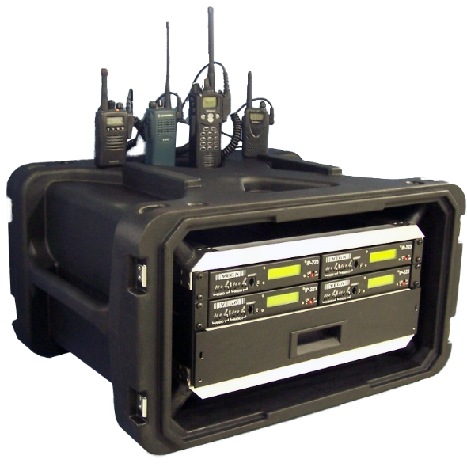
Future Capabilities

Slide 8
Verizon Emergency Response Team
COWs, COLTs and Cellular service
Provides phones, extenders, jetpacks and routers
Cow’s and Colt’s are different and require reimbursement for deployment charges ($10-40k for back haul)
Backhaul may consist of fiber, T-1 or microwave
Can provide SatCom using VIASAT @ $75/GB (service charge)
Provide support to all risk incidents
Emergency Contact (800) 981-9558

Slide 9
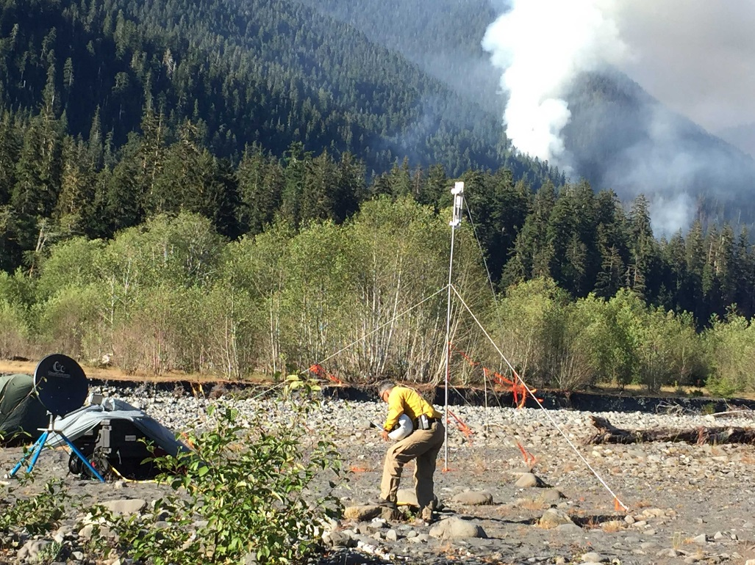
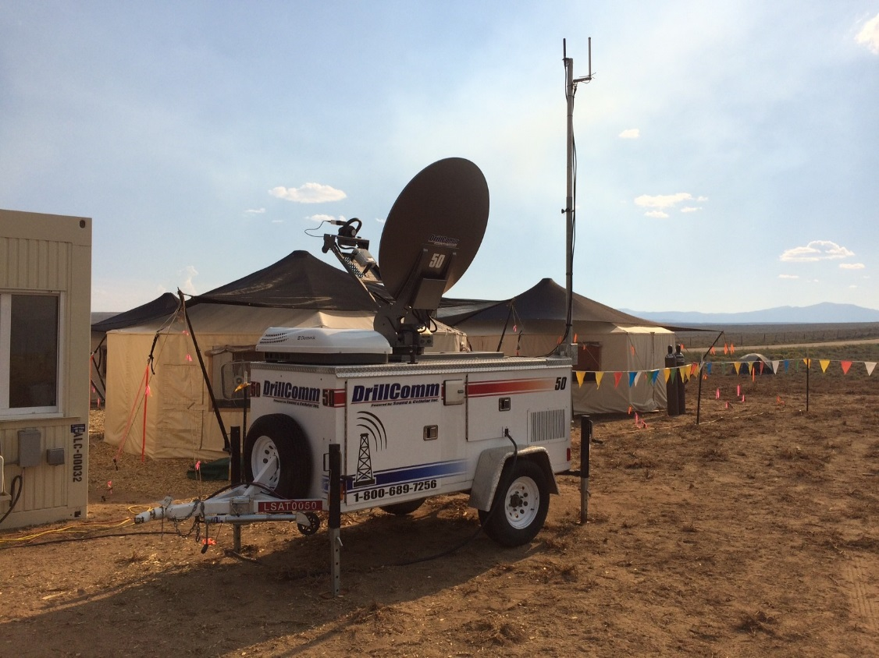
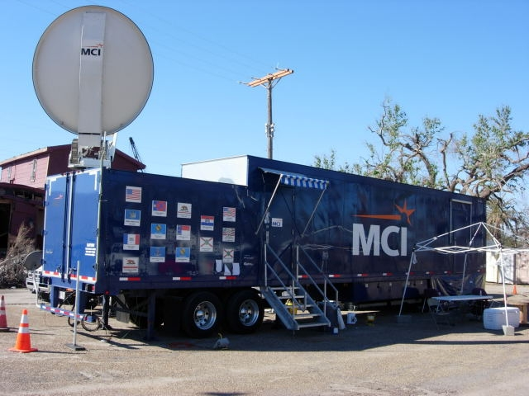
Questions?

Slide 10
Eric Martinez email: epmartinez@fs.fed.us Phone: (951) 315-3017

