Slide 1
Preseason Incident Blanket Purchase Agreements (I-BPA) and Virtual Incident Procurement (VIPR)
Prepared for the National Logistics Webinar
7 March 2017

Slide 2
Discussion Items
2016 VIPR Season in Review & Current Events
2017 I-BPA Program – Overview of latest solicitations
2018 I-BPA Program – Overview of solicitations currently being reviewed
Scope of Solicitations
National Solicitation Plan
VIPR Activity
Administration of the I-BPA
Dispatch Operations
Ordering Equipment
Notes:
For the last 12 slides of the power point I’ll review some slides that are specific to the Logistics group.

Slide 3
Discussion Items
Inspections
Incident Contract Project Inspector
Vendor Relationships
Questions?
Notes:
For the last 12 slides of the power point I’ll review some slides that are specific to the Logistics group.

Slide 4
2016 VIPR Help Desk Season in Review
VIPR Helpdesk
Available 24/7
Helpdesk Ticket Information
Total number of tickets created October 2015 thru September 2016: 2,860
http://www.fs.fed.us/business/incident/vendorsupport.php
Notes:
2016 experienced a large number of outages.
Contracting Officer -- 453
Other (vendor, etc) – 2,407
We also got a new Helpdesk, which is now physically located in Michigan.

Slide 5
VIPR Current Events
VIPR Server Moves
VIPR moved from MCI to the VDC 22 Dec 2016, then moved from the RAC to a Single Server Database Instance on 2/14/2017
Transforming Incident Procurement Project (TIPP)
Aging systems and processes do not meet OMB mandates, many incident business processes are manual, duplication and inconsistencies exist among agencies, and proper administration of incident contracted resources is lacking.
EERA/LUA Working Group
The working group is looking at providing examples of commonly hired equipment using the Incident-Only EERAs/LUAs.
Notes:
5
VIPR was having a lot of unexpected outages after the migration to the VDC. It was determined that VIPR needed to move to a Single Instance Database in DEV, TEST, and PROD -- away from the VM Cluster. The intense workload and traffic on the VIPR DB server is triggering problems with the VMware (VMotion). VMotion tries to balance workload by moving VMs from one host in the VM Cluster to another. When this VM movement takes place, Oracle responds by rebooting the server, causing unexpected and frequent outages.
Intermittent problems were observed/reported that users could not log in, they were getting errors when accessing VIPR, or they would get dropped. Errors included failed attempts to log in and seeing a message stating, “Exception was thrown in SecurityFilter:JDBC rollback failed; only seeing the header and footer after logging in; or instances when error messages were received stating, “The process has failed due to an unexpected failure”.
The VIPR Tech Team no longer has access to the application logs, which could be used to assist with troubleshooting what causes the various errors. Mike Galicki from CIO was requested to assist with reviewing the logs; however, unless the log is monitored while the errors are occurring, it is difficult to pinpoint the problem.
On 1/13/17, feedback was received that one of the 2 servers (# 0628) was full and had run out of disk space. CIO was asked to delete unnecessary files. The VIPR Tech Team questioned the reliability of Load Balance servers and requested additional RAM for server # 0628.
On 1/17/17, a VIPR Outage was reported. It was discovered that Server # 0628 was completely full and server #0514 needed to be restarted.
There are two servers that VIPR utilizes on VDC to help with ‘load balance’, which is supposed to help prevent the system from getting bogged down and slow when use is heavy. The load balancer uses health probes to all the servers and if the load balancer sees a problem with one of the servers it will send all the traffic to the alternate server.
On 1/18/17, server # 0514 was shut down at 2:05 pm. The VIPR Tech team had rec’d copies of log files from CIO that showed over 1500 errors on server # 0514 starting from 13 Jan. There were only 2 errors on server # 0628. The team made the immediate recommendation to shut down server # 0514, feeling it was better to have a slow system without a load balance back-up, than to have constant user failures in the application.
TIPP Vision: Incident business management organizations provide efficient, streamlined, collaborative, support, contributing to the safety of personnel and effectiveness of operations. Service First authority is maximized. Incident business processes and systems are structured, adhere to acquisition and financial management requirements, and are managed to facilitate agile change.
Over 1.2 billion dollars are spent annually on cooperative fire agreements, incident procurements, and AD hiring.
It is time to streamline processes, modernize systems, and improve delivery of incident business services.

Slide 6
2016 I-BPA Program
Solicitations for 2016 (all re-solicitations)
Heavy Equipment with Water
Water Handling
Refrigerated Trailer
Weed Washing Unit
Acquisition Management
USDA Forest Service
6
Notes:
The last two would normally fall under the Logistics group
National:
Crew Carrier Bus
Communications Trailer
Regional:
Gray Water/Potable Water/Trailer Mounted Handwashing Station
Mechanic with Service Truck
Mobile Laundry
Mobile Sleeper
Portable Toilet/Portable Handwashing Station/Accessible Portable Toilet
Refrigerated Trailer
Tent and Canopy
Weed Washing Unit
Local:
ATV/UTV
Chainsaw Repair Service
Chipper
Coach Bus
Fuel Tender
Line EMT with Medical Kit (Pending)
Mobile Sleeper Unit
Vehicle with Driver
Vehicle Rental

Slide 7
2017 I-BPA Solicitations
Currently being Solicited & Awarded
Faller Module (Single and Module)
Fuel Tender
Heavy Equipment (Dozer, Tractor Plow, Excavator, Transport)
Mechanic with Service Truck
Tent and Canopy
Vehicle with Driver
Notes:
Those that are highlighted may fall under administration or management by the Logistics group. All of these are resolicitations, which means we have solicited for these using a template supported by VIPR previously.
Faller: R1, R2, R4, R5 , and R6 are soliciting for this resource using the template in VIPR.
Fuel Tender: R2, R3, R4, R5 and R6 are soliciting for this resource using the template in VIPR.
HE: R1, R2, R3, R4, R5 and R6 are soliciting for this resource using the template in VIPR.
MWST: R1, R2, R3, R4 and R6 are soliciting for this resource using the template in VIPR.
Tent: R3 and R5. All other Regions are using source lists and plan to initiate agreements on an incident-only basis.
Vehicle with Driver: R4, R5 and R6 are soliciting for this resource using the template in VIPR.

Slide 8
Next Year: 2018 I-BPAs under Review
Re-solicitations include:
Chipper
Gray Water Truck, Potable Water Truck, and Trailer Mounted Handwashing Station
Miscellaneous Heavy Equipment (includes Feller Buncher, Mulcher/Masticator-Boom Mounted, Strip Mulcher/Masticator, Road Grader, and Skidder
Mobile Laundry
Mobile Sleeper Unit (R5)
Portable Toilet, Portable Handwashing Station, and Wheelchair Accessible Portable Toilet
Webinar to review solicitation changes coming in April.
Notes:
Those that are highlighted may fall under administration or management by the Logistics group. All of these are resolicitations, which means we have solicited for these using a template supported by VIPR previously.
Chipper, may be applicable to Logistics if the operation is for base camp.
Gray Water/Potable Water/TMHS, all Regions except R8 and R9 are anticipated to use the VIPR template to solicit for this resource. In 2015, R1 had solicited for this but BLM had the lead – Not sure if this will be the same in 2018.
MHE Road Grader, may be applicable to Logistics if Ground Support is involved in the road grading operations. All Regions except R9 are anticipated to solicit for this resource using the template in VIPR.
Mobile Laundry is expected in R2, R3, R5, and R6.
Mobile Sleeper, used in R5.
Portable Toilets, only R5 used it in 2015. All other Regions were using source lists and plan to initiate agreements on an incident-only basis. In R1, MT DNRC was soliciting these for the geographic area. Consideration may be given to removing this template from VIPR for 2018.
Webinar to review solicitation changes coming in April.
Hosted in the Acquisition Community Training (ACT) Forum.
Registration through AgLearn
Continuous Learning Points will be given

Slide 9
Scope of Solicitations
I-BPAs are solicited on three primary levels as identified in the National Solicitation Plan for I-BPAs
http://www.fs.fed.us/business/incident/static/National%20Solicitation%20Plan%20for%20I-BPAs%20revised%20October%2028%202014.pdf
National
one solicitation for all regions
Regional
one solicitation in each region
Two regions can partner to issue inter-regional solicitations as appropriate
Local
solicitation level and acquisition cycle determined by the region (forest, zone, region)
will vary and can be different from region to region
Notes:
National specifications and templates will be used; for national solicitations resource categories are determined through collaboration between WO AQM and FAM; when considering preseason or at-incident agreements, regions should consider the potential dollar amount over the life of the I-BPA, availability of resources and workload.

Slide 10
National Solicitation Plan for I-BPAs: National and Regional
Equipment Category | Solicitation Year for Incident Blanket Purchase Agreements
 | FY 2015 | FY 2016 | FY 2017 |  | FY 2018 | FY 2019 | FY 2020 |  | FY 2021 | FY 2022 | FY 2023 |  | FY 2024 | FY 2025 | FY 2026
National
Bus, Crew Carrier |  |  |  |  |  | RR |  |  |  |  |  |  | RR
Clerical Support Unit |  |  |  |  |  | RR |  |  |  |  |  |  | RR
Communications Trailer |  |  |  |  |  | RR |  |  |  |  |  |  | RR
GIS Unit |  |  |  |  |  | RR |  |  |  |  |  |  | RR
Helicopter Operations Support Trailer |  |  |  |  |  | RR |  |  |  |  |  |  | RR
Mobile Laundry (National in 2018) |  |  |  |  | RR |  |  |  |  |  | RR
Refrigerated Trailer (Regional in 2013)
Regional
Heavy Equipment with Water: |  | RR |  |  |  | RR |  |  |  | RR |  |  |  | RR
Pumper Cat
Skidgine
Softtrack
Refrigerated Trailer (Regional in 2013) |  | RR |  |  |  | RR |  |  |  | RR |  |  |  | RR
Water Handling Equipment: |  | RR |  |  |  | RR |  |  |  | RR |  |  |  | RR
Engine
Water Tender (Support)
Water Tender (Tactical)
Weed Washing Unit |  | RR |  |  |  | RR |  |  |  | RR |  |  |  | RR
Clerical Support Unit (National in 2014)
Faller Module (Single and Module) |  |  | RR |  |  |  | RR |  |  |  | RR |  |  |  | RR
Heavy Equipment: |  |  | RR |  |  |  | RR |  |  |  | RR |  |  |  | RR
Dozer
Tractor Plow
Excavator
Transport
Mechanic with Service Truck |  |  | RR |  |  |  | RR |  |  |  | RR |  |  |  | RR
Tent and Canopy |  |  | RR |  |  |  | RR |  |  |  | RR |  |  |  | RR
Gray Water Truck | RR |  |  |  | RR |  |  |  | RR |  |  |  | RR
Handwashing Station, Trailer Mounted
Potable Water Truck
Mobile Laundry (National in 2018) | RR
Toilet, Portable | RR |  |  |  | RR |  |  |  | RR |  |  |  | RR
Toilet, Portable, Wheelchair Accessible
Handwashing Station, Portable
Acquisition Management
USDA Forest Service

Slide 11
National Solicitation Plan for I-BPAs: Locals
Equipment Category | Solicitation Year for Incident Blanket Purchase Agreements
 | FY 2015 | FY 2016 | FY 2017 |  | FY 2018 | FY 2019 | FY 2020 |  | FY 2021 | FY 2022 | FY 2023 |  | FY 2024 | FY 2025 | FY 2026
Local (see Exhibit B)
Fuel Tender |  |  | RR |  |  |  | RR |  |  |  | RR |  |  |  | RR
Helicopter Operations Support Trailer (National in 2014)
Vehicle with Driver (includes Passenger Vehicles and Trucks) |  |  | RR |  |  |  | RR |  |  |  | RR |  |  |  | RR
Chipper | R |  |  |  | RR |  |  |  | RR |  |  |  | RR
Miscellaneous Heavy Equipment: | R |  |  |  | RR |  |  |  | RR |  |  |  | RR
Feller Buncher Mulcher/Masticator (Boom Mounted) Strip Mulcher/Masticator Road Grader Skidder
Generic | R |  |  |  | RR |  |  |  | RR |  |  |  | RR
Computers - The Agency will use commercial procedures, or establish a Regional or Local BPA.
Local I-BPAs are optional & solicited at the discretion of each region; therefore, not counted or recognized as a part of the national workload.
Trailers (Clerical Support Unit, Communications Trailer, GIS Unit, and Helicopter Operations Support Trailer) - all trailers were moved from Local and Regional to a National solicitation in 2014, and now done by ISB.
Generic Template is supported in VIPR as a Local solicitation template. The Generic template can be used to acquire other resources as identified on the Equipment and Method of Hire National Standards Chart, Exhibit 23 in the Interagency Incident Business Management Handbook.
http://www.fs.fed.us/business/incident/compsolplan.php
Acquisition Management
USDA Forest Service
Notes:
Local I-BPAs are solicited on a 2-year cycle. This also now includes the Generic Template.
The introduction of competition for local resources completes recommendations of the OIG Audit (05601-40-SF).

Slide 12
VIPR Activity Report
Year | Solicitations | Vendor Responses | Signed Agreements | Vendor Resources
2012 | 62 | 721 | 658 | 2251
2013 | 22 | 1306 | 1248 | 3502
2014 | 37 | 1511 | 1405 | 5592
2015 | 24 | 699 | 851 | 2424
2016 | 26 | 1126 | 1351 | 3405
Totals | 171 | 5363 | 5513 | 17174
Acquisition Management
USDA Forest Service
12
Notes:
Solicitations include all those showing up in VIPR. This includes Awarded, Expired (CSU was awarded, protested, then cancelled), Closed, and any that have Pre-Synopsis.
For 2017, as of 3/5/15, all but 3 solicitations are open.
The total number of vendor resources does not account for any resources that have been suspended.
Why is the number of agreements so high for 2014?
The Heavy Equipment solicitation has a lot of resources
R1 – 117 agreements, 319 resources;
R2/R4 – 90 agreements, 374 resources,
R3 – 60 agreements, 167 resources;
R5 – 212 agreements, 972 resources;
R6 – 188 agreements, 523 resources;
R8 – 16 agreements, 230 resources;
R9 – 9 agreements, 39 resources
TOTAL: 692 agreements, 2624 resources.
The other big one was Fallers
R1 – 15 agreements, 140 resources;
R2/R4 – 13 agreements, 60 resources;
R5 – 51 agreements, 295 resources;
R6 – 53 agreements, 333 resources
TOTAL: 132 agreements, 828 resources.
Numbers do not include any interagency efforts, only what is in VIPR.

Slide 13
Administration of the I-BPA
What do I need to know about the I-BPA?
Standardized provisions vs. template specific; the following clauses and/or exhibits are template specific and the remaining clauses are standardized in all the templates.
D.1 – Scope
D.2 – Technical Specifications
D.3 – Personnel Requirements
D.6 – Attributes
Exhibit J – Attributes
Exhibit M
What do I do if the equipment breaks down?
D.21.8.3 - Exceptions
Coordinate with Procurement Unit Leader, Finance, the ICPI, or the Contracting Officer for the agreement.
Notes:
Not all solicitations have an Exhibit J or and Exhibit M.

Slide 14
Dispatch Operations
CO & Dispatch Communications are Critical
VIPR does not replace verbal communications or the CO/Dispatcher relationship/responsibility
National Dispatch Standard Operating Guide for Contracted Resources
Provides detailed operating guidelines
http://www.nifc.gov/nicc/logistics/references.htm
Acquisition Management
USDA Forest Service
14
Notes:
Dispatch Data Entry Report for ROSS is a Excel spreadsheet that provides vendor & equipment information needed to populate vendor fields in ROSS; Dispatch SOG will be reviewed annually and updated as needed by WO FAM Operations. I will show an example of a Dispatch Priority List (DPL) in a few slides.

Slide 15
Ordering Equipment
How should we order equipment?
DPL overview – Dispatcher orders off the DPL for the equipment being requested.
Incident-only EERA – If no equipment is on the DPL, or determined to be too far to order off DPL, then an Incident-only EERA may be initiated.
What are some of the issues with equipment ordered?
Date and time needed
Payment issues
Notes:
Date and time needed – we continuously hear about vendors not meeting date and time needed. Please document these instances and make sure they get forwarded to the CO for the agreement. Coordinate with the Finance group (PUL if one is assigned). Was date and time needed reasonable?

Slide 16
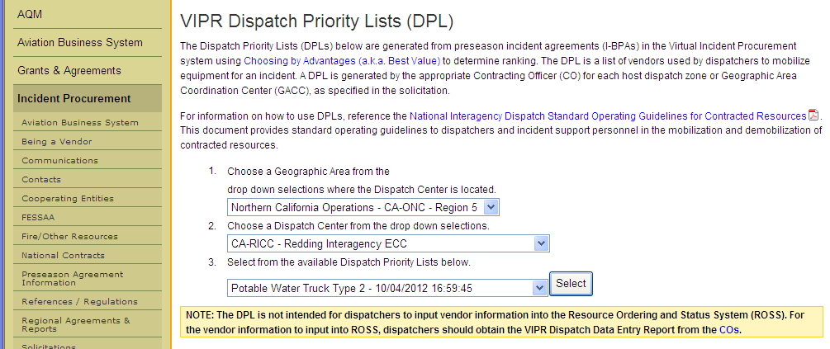
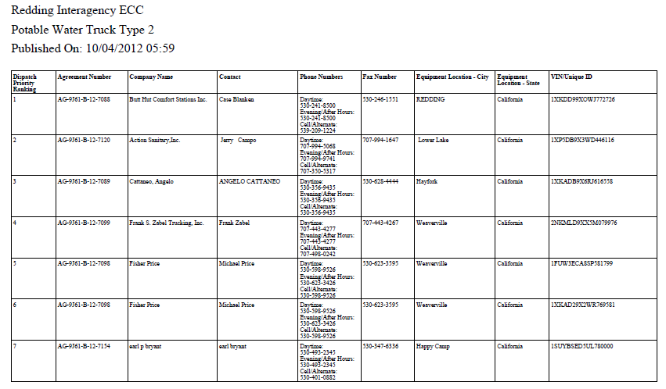
Ordering Equipment
Screen Shot for selecting a DPL
http://www.fs.fed.us/business/incident/dispatch.php
Notes:
How does dispatch know a DPL has been posted? Until the VIPR-ROSS interface is functional, the CO will send a Dispatch Data Entry Report to the appropriate Dispatch Center. This is a report the CO can run in VIPR.

Slide 17
Inspections – Overview
What do I need to know about inspections?
D.16 – for most of the equipment, the decision was made to not do pre-season inspections (we don’t have the personnel to do the inspections); exception for inspections is the Water Handling and Heavy Equipment with Water solicitations.
D.17 – inspection clause once equipment arrives at incident.
Exhibit M – in the Water Handling and Heavy Equipment with Water solicitations/agreements.
OF-296 or Compliance Inspections (see R5 portal) http://www.fs.usda.gov/detail/r5/fire-aviation/management/?cid=stelprdb5365911

Slide 18
Inspections – Incident Pre-use
What if the wrong equipment shows up or it doesn’t pass inspection or it breaks down at the incident?
D.17 Incident Pre-Use Inspection:
All resources furnished under this agreement shall be in acceptable condition. The Government reserves the right to reject resources that are not in safe and operable condition. Prior to incident use or anytime the resource is under hire, the Government will perform inspections.
If the resource does not pass inspection at the incident or designated inspection station, it is considered noncompliant. The Contractor may be given 24 hours or time frame designated by Government representatives to bring the resource into compliance. If the resource does not pass inspection, no payment will be made for travel to the incident or point of inspection or return to the point of hire, or for the time that the resource was not available. Upon rejection, resource will be removed from the dispatch priority list until such time that the resource is brought into compliance and re-inspected at the government’s convenience. Repeated failures at the pre-use incident inspection may be grounds for cancellation of the Agreement.

Slide 19
Inspections
What if the wrong equipment shows up or it doesn’t pass inspection or it breaks down at the incident?
D.18 NONCOMPLIANCE AFTER ACCEPTANCE AT THE INCIDENT
If the resource is released due to noncompliance, documentation shall be immediately forwarded, by the Incident Management Team to the Contracting Officer; and the resource will be removed from the dispatch priority list until such time that the resource is brought into compliance and re-inspected at the government’s convenience (See D.21.8.3(c)). Repeated notices of noncompliance may be grounds for cancellation of the Agreement.
IMPORTANT: If you are not sure about whether the equipment meets the specifications or are unsure about whether or not to accept a particular resource, consult with the Procurement Unit Leader and/or the Contracting Officer for the agreement.

Slide 20
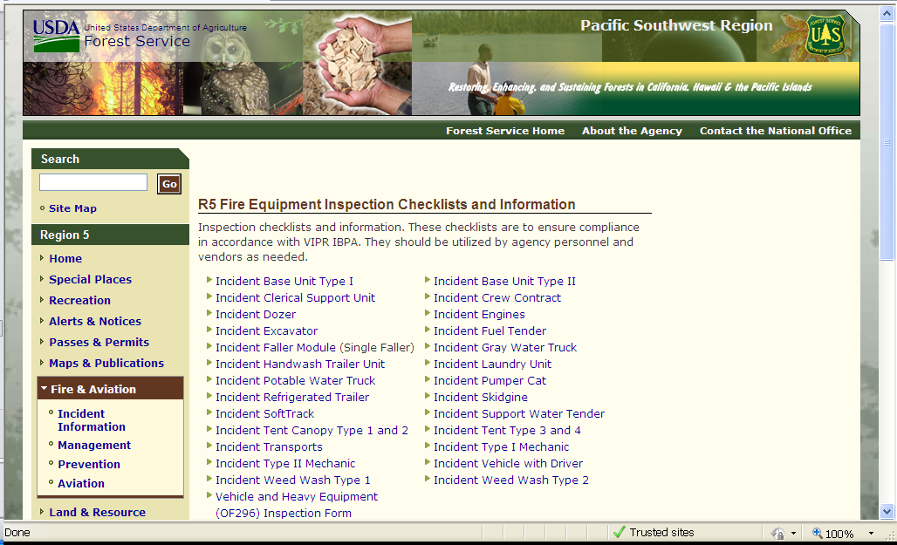
Inspections – Link to R5 Checklists
http://www.fs.usda.gov/detail/r5/fire-aviation/management/?cid=stelprdb5365911
Future Site: http://www.fs.fed.us/business/incident/equipment.php
Notes:
All inspection checklists are currently being revised. They will be posted once finalized.

Slide 21
Inspections – Link to R5 Checklists
Sample Inspection Form – Laundry Unit (page 1 of 2)
Notes:
Inspection Checklists are currently being revised and once finished will be posted at: http://www.fs.fed.us/business/incident/equipment.php

Slide 22
Incident Contract Project Inspector (ICPI)
Tell me more about the ICPI?
A new position for incident support, called an Incident Contract Project Inspector (ICPI), has been created to provide subject matter experts at incidents for our contracts and I-BPAs. ICPIs were ordered for many fires this season with much positive feedback received.
What do they do?
ICPIs travel to various incidents inspecting contract equipment and operators for contract compliance, generate remedies for non-compliant resources, advise the incident supervisor of contract/agreement specification requirements, and assure that performance ratings are completed for each contractor. They can ensure contract compliance for all contracts and I-BPAs except the national Mobile Showers, Mobile Food Caterers, and Aviation contracts.
Notes:
ICPI could be assigned to one assignment, or several assignments, depending on availability and proximity to other incidents.

Slide 23
Vendor Relationships
What do I need to know about working with vendors?
Do you have an ICPI?
Do you know where to find the performance evaluation report?
Are you familiar with D.20?
Exhibit E?
What if you don’t have an ICPI?
Consider ordering one
Work with Finance, specifically the Procurement Unit Leader if one is assigned to the incident
Notes:
New simplified Contractor Performance Rating (February 2015) to be posted at: http://www.fs.fed.us/business/incident/equipment.php

Slide 24
Contractor Performance Rating
Notes:
New simplified Contractor Performance Rating (February 2015) to be posted at: http://fsweb.wo.fs.fed.us/aqm2/wo/incident/eera/perf_eval.php

Slide 25
Contractor Performance Rating - Guidelines
Notes:
New simplified Contractor Performance Rating (February 2015) to be posted at: http://fsweb.wo.fs.fed.us/aqm2/wo/incident/eera/perf_eval.php
See Exhibit E for the Rating Guidelines.

Slide 26
Questions
Presented by:
Brandy O. Jiron, Procurement Analyst Fire and Aviation Business Branch (FABB)
National Logistics Workshop, 7 March 2017
http://www.fs.fed.us/business/incident/
Notes:
26

