Slide 1
INCIDENT CONTRACT PROJECT INSPECTOR (ICPI)
Nationally there are many types of equipment agreements and approximately 25 resource categories within the Virtual Incident Procurement (VIPR) program
To support contract compliancy, the ICPI position was established April, 2012
Listed as NWCG course S-262 with task book
Serves as Subject Matter Expert for agreements/contracts
Authority is not delegated, but is expected that the ICPI understands the contract. The ICPI should always be communicating with Finance Section on the Incident and if needed elevate to the COR or CO of the agreement
ICPI doesn’t demob equipment that did not pass inspection or doesn’t meet minimum agreement specifications, only makes recommendations to the incident
Notes:
Slide 1-8: Incident Contract Project Inspector (ICPI)

Slide 2
Duties and Responsibilities
ICPI’s
Are an on the ground resource that is the liaison for the Contractors and Agency personnel on all matters pertaining to VIPR agreements that are utilized at an incident
Performs incident compliance inspections of VIPR contracted resources
Are first line of support for issues as they arise during an incident
Uncovers and gathers documentation that may be needed to settle incident concerns in the future
Notes:
Slide 1-11: ICPI

Slide 3
Duties and Responsibilities Cont.
Works for Procurement Unit Leader or Finance Section Chief
Attends daily shift briefings
Assist with clarification of agreements
Establishes clear lines of communication, from incident up to FAM Contract Specialists and or Contracting Officers
Notes:
Slide 1-9: Duties and Responsibilities

Slide 4
Duties and Responsibilities Cont.
Documents and reports non-compliance
Informs incident supervisor / Incident Management Team personnel of significant problems
Ensures performance evaluations are completed
End of incident, forwards documentation to FAM Contract Specialists and or Contracting Officer
Notes:
Slide 1-10: Duties and responsibilities

Slide 5
Uses for ICPI
Confirm ordered equipment is the correct resource as per Dispatch Priority List (DPL)/Resource Order
Support incidents on compliance inspections and or contract interpretation
Your resource to contact if there are questions/concerns on the various agreements/contracts

Slide 6
The ICPI Does Not:
Perform mechanical inspections
Make contractual decision or payment interpretations
Make monetary promises or solicit claims
Determine needs of the incident
R5- doesn’t typically use Equipment Inspector (EQPI) (when the EQPI is also qualified as ICPI) to do work of an ICPI during the same assignment. (these positions have two different authorities)
Slide 1-12
Notes:
Slide 1-12: The ICPI is not:

Slide 7
Arriving at the Assignment
Most common vendor feedback is getting inspected at the same incident multiple times
Once at the incident, it’s important that the ICPI’s check in finance to verify that an inspection has been completed, if so, they do NOT need to re-inspect. UNLESS they see or have any concerns
If a vendor doesn’t need a secondary inspection, it’s still important to check in with a vendor even after inspection to see how their assignment is going
The ICPI’s goal should not be to find something wrong during their inspections, rather they should support the vendor in being successful in meeting the provisions of their agreement

Slide 8
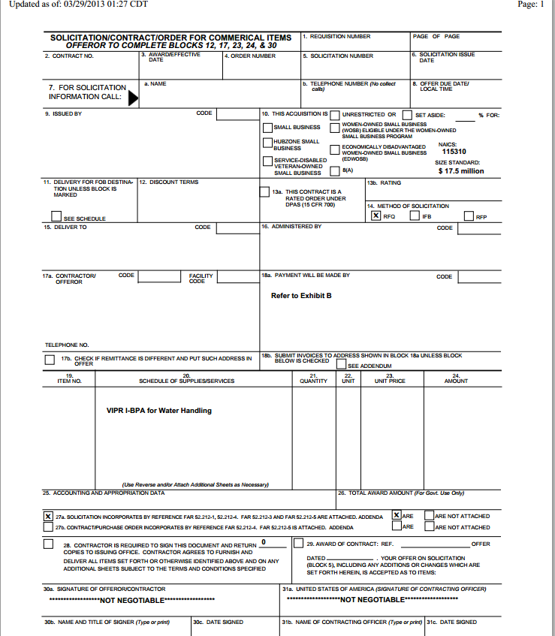
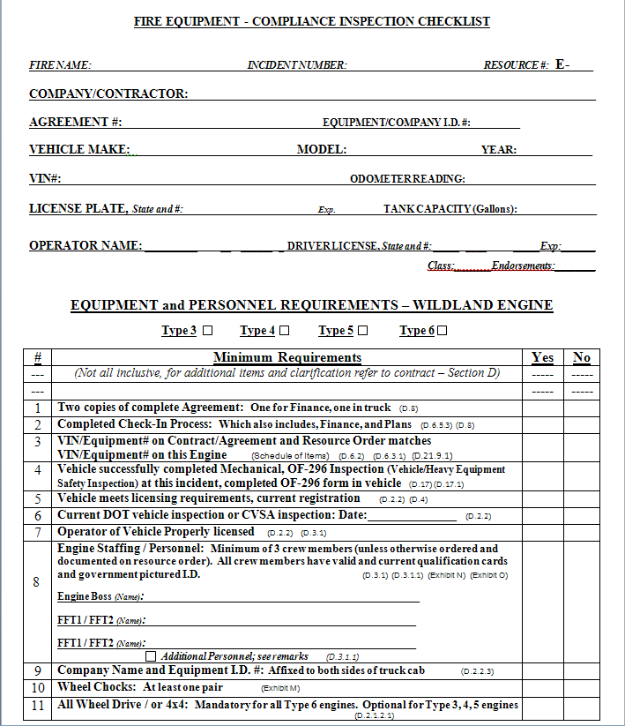
Compliance- ICPI inspections use the agreement and checklist to determine the vendor is meeting the agreement specifications
If a vendor/equipment is rejected on a compliance issue, document who performed the inspection. And be sure to inform Regional FAM/AQM Program Personnel.

Slide 9
Fire Operations Agreement Checklists and Information
Provides the minimum agreement specifications
Checklist are currently being updated for 2017 fire season
https://www.fs.fed.us/business/incident/equipment.php

Slide 10
D.20 PERFORMANCE EVALUATIONS
Performance evaluations will be performed at the incident using the form in Exhibit E.

Slide 11
National Qualified and Trainee ICPI’s
Region 1
11 qualified ICPI's
New trainees currently being organized from recent completed ICPI course
Region 2
3 qualified and 10 trainees
Region 3
18 qualified and 24 trainees. Trainee list will be updated for 2017 season
Region 4
14 qualified and 29 trainees
Region 5
18 qualified, 20 trainees. Trainees list will be updated after April 2017 ICPI course
Region 6
49 qualified and 103 trainees
Region 8
10 qualified ICPI’s and 9 Trainees

Slide 12
Incident Contract Project Inspector ordering
Ask your Regional Fire Contract Specialist for your Region’s local ordering protocol.
Examples how R5 ICPI’s can be dispatched and assigned
Ordered placed by the Incident
By Region, assigned to multiple incidents
By GACC’s, staged to inspect incoming resources

Slide 13
Regional FAM VIPR Program Leads
And new to the group, Mary Fields-NIFC

Slide 14
Questions?

