Slide 1
National Mobile Food Services
Contract Changes
2015 - 2019

Slide 2
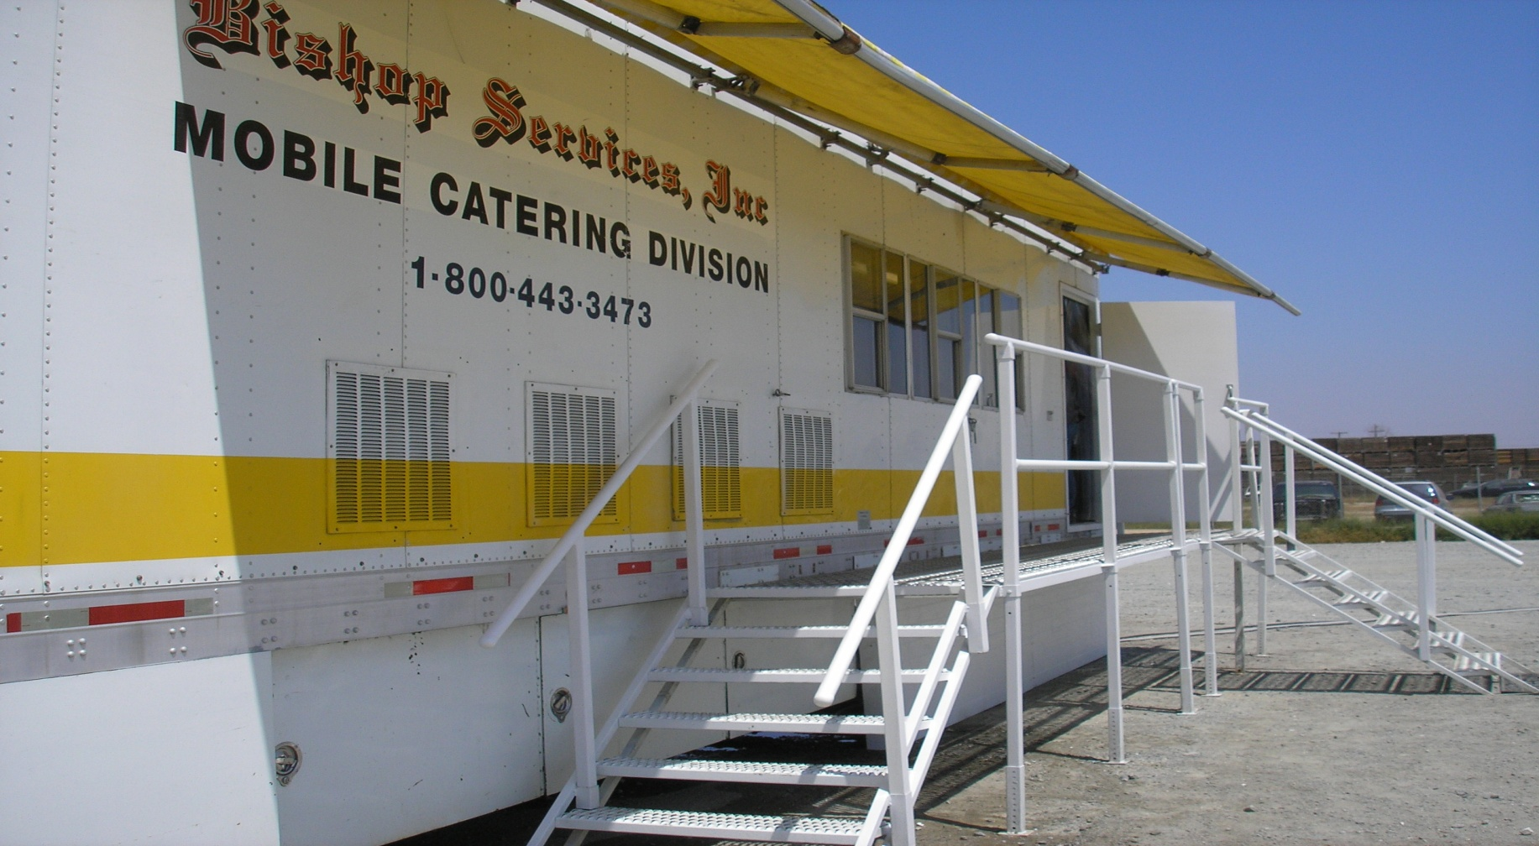
Kitchen Unit

Slide 3
Major Changes in the National Mobile Food Services Contract for 2015-2019
These are just some of the major changes in the new Food Contract, please read the entire Food Contract to see all of the changes.
The Map of Designated Dispatch Points (DDP’s) is still 30 locations and there are 29 kitchens. One kitchen has a dual location.
Unit Summary changes:
The rate per meal changes yearly, make sure you have the current year Unit Summaries.
Relocation Fee was bid by the contractor and is now in the amount each vendor provided in their solicitation offer. They range from $1000 per move to $3500 per move.
VIN numbers are no longer required on vehicles; we are using the Company ID and Unit Identification Numbers only.
Notes:
Relocation Fees are Bid . The Government no longer sets the price

Slide 4
Major Changes in the National Mobile Food Service Contract
There are fewer items on the available through the Supplemental Foods and Beverages.
Many of the caterers have an option to order individual sandwiches. The sandwiches are priced individually and are available as a meat sandwich or non-meat sandwich.
The sandwich option was agreed upon to in response to requests for smaller lunches for in camp personnel.
Additional Tents & Seating/per 60 Persons is also available as an optional item.
There may be other minor wording changes for clarification, that are no included in this summary.

Slide 5
MFSU C.1 (b) GOVERNMENT FURNISHED PROPERTY
C 1(c)(4) Potable Water – The Government will deliver potable water to the MFSU, as needed after the first 480 required gallons required to be furnished by the contractor is used.
. C 1(c)(6)(iv) Meal Count - Caterer employee meals will be counted as part of the daily meal count. The caterer is responsible for notifying the FDUL of the initial employee count and any changes to that number thereafter.
Notes:
Self explanatory

Slide 6
MFSU C.1 GOVERNMENT FURNISHED PROPERTY
C 1(c)(8) Fuel Tender – the Government may allow the Contractor to use a Government fuel tender when available. The Contractor shall pay directly via credit card for any costs of these supplies. At times it may be necessary for the Contractor to deduct the cost of petroleum products from payments on Form 1276-B Daily Meal Order/Invoice – Mobile Food Service Continuation Sheet when no credit card services are available.

Slide 7
MFSU C.1 GOVERNMENT FURNISHED SERVICES:
C.1(c)(11) Hot and Cold Can Assembly – When available, the government may provide personnel to assemble the cardboard sections of the hot and cold containers. This service may not be available at all incidents. Requests for help must be sent through the FDUL.
Notes:
This was added to give assistance with larger hot can operations since it was a government change in equipment. Its NOT mandatory.

Slide 8
C.1. CONTRACTOR FURNISHED EQUIPMENT, SUPPLIES AND PERSONNEL:
C.1(d)(15) - A minimum of 500 gallons potable water storage capacity (see C.3(a)(3) and initial supply of 480 gallons of potable water.
Notes:
C.1.4.1 New requirements for biobased products. What they use including cleaning products should be part of their contract. But they are also allowed to make changes as long as the y meet biobased/preferred definition
C.1.4.13 Biobased liners are required.
C.1.4.16 Gray water Increase from 500 to 1000 gallons
C.1.4.18 Proper fire extinguishers
C.1.4.21 Contractor furnishes meals for employees. No meal clicks

Slide 9
C.2(c)(4) RELEASE and/or REASSIGNMENT:
The FDUL may release the Contractor after it is determined there is no longer a need for mobile food or when the number of people to be served per meal period is anticipated to stay below 150 for the remainder of the incident.
Notes:
C.2 Ordering hasn’t change much. Removed redundant clauses and wording and rearrange clauses .

Slide 10
C.3 MINIMUM MOBILE FOOD UNIT EQUIPMENT REQUIREMENTS:
C.3(a)(1)(vii)Ventilation Equipment
(B) All exhaust hood ventilation systems shall be equipped with an NFPA approved automatic fire extinguisher system.
C.3(a)(3) Potable Water Storage Tank – Storage capacity changed to 500 gallons
Notes:
C.3.1.1.1(a) Cleared up what the effective means may be. FDUL can determine if efforts are effective.
C.3.1.1.1(d) Wood pallets can be used.
C.3.1.1.4 New clause requiring dedicated food prep sink
4. C.3.1.1.5 Hand sinks required within all food prep etc., areas used to say in close proximity.

Slide 11
C.4 MINIMUM MOBILE FOOD REQUIREMENTS :
C.4(b) Standard Meal Requirements –
C.4(b)1 Hot Breakfast
(iii) Bread is now a stand alone requirement of 1 – 1 ½ oz.
(iv)Pancakes, French Toast or Waffles are now a stand alone requirement 3 -4 oz..
C.4(b)3Cold Container Breakfast
(ii) Breakfast Protein Item – increase to 8 oz.
(v) Fruit – Increased the dried fruit weight to 4 oz.
Notes:
C.3.1.1.6 Bladder bags are prohibited for potable water storage.
C.3.1.1.10 Clarified where sneeze guards are required
C.3.1.1.11 Increase grey water storage by 500 gallon

Slide 12
C.4 MINIMUM MOBILE FOOD REQUIREMENTS
C.4(b) Standard Meal Requirements –
C.4(b)5 Sack Lunch -
The sack lunches consist of four categories of food items.
Primary Meal – 1 Sandwich/Wrap
Secondary Meal – 1 item from this category
Salads, Fresh Fruit and Fresh Vegetables – 2 items from this category
Energy Snacks – 6 items from this category

Slide 13
C.4 MINIMUM MOBILE FOOD REQUIREMENTS :
C.4(b)5 Sack Lunch (continued)-
No two items in each category shall be the same.
To insure variety, lunch items shall not be repeated in a three day period
Read Sections C.4(d), C.4(g) and Attachment J.5A for Sack Lunch Options

Slide 14
J.10 DEFINITIONS
Has definitions of many of the terms used in the contract.
.

Slide 15
Questions?

Slide 16
Contact Information
Mary Fields
Contracts Program Manager
Forest Service
WO-FAM NIFC
P: 208-387-5092
C: 406-370-7312
F: 208-387-5398
mfields@fs.fed.us

