Slide 1
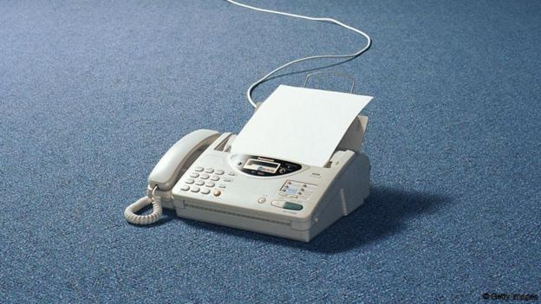
The Fax Line & Ordering
Tony Martinez, LSC1
Los Padres National Forest
trmartinez@fs.fed.us
805.452.4284

Slide 2
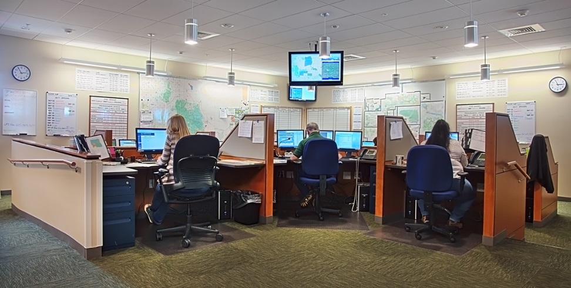
LPCC@FS.FED.US
Buying Team
An ORDER
(ICS-213 / Resource Order Card)
Expanded

Slide 3
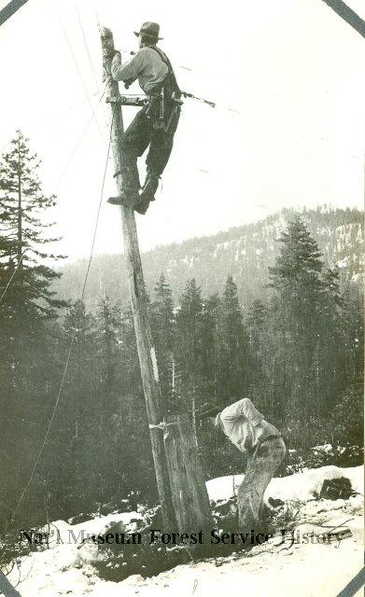
No Hard Lines
Satellite will not support Fax
An ORDER
(ICS-213 / Resource Order Card)
Expanded / Buying Team Resistant to email

Slide 4
Public Law 113–187
‘‘Presidential and Federal Records Act Amendments of 2014’’
‘‘(a) IN GENERAL.—An officer or employee
of an executive agency may not create
or send a record using a non-official
electronic messaging account…
An ORDER
(ICS-213 / Resource Order Card)

Slide 5
Be an advocate to get hard lines in at traditional camps
Invest in up front time with BUYT/Expanded
Consider the cost of separating ORDM from ICP
Continue discussion of moving away from old technology
Answer the call for a working group

Slide 6
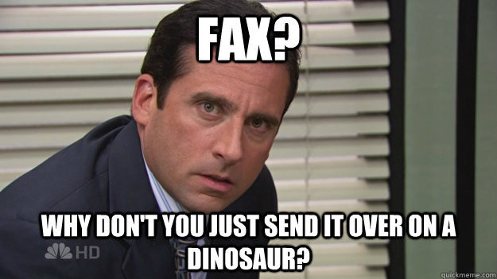
Thank You Tony

